Slide 1


Energy Transition for Achieving Net Zero in India
National Level Interaction Meet
Energy-Water-Food Nexus : Challenges Ahead
Ahmedabad
7th October 2022
Dr V K Saraswat
Member
NITI Aayog

Slide 2
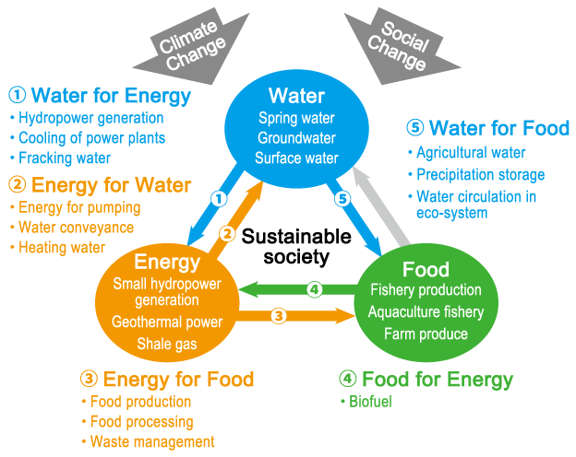

Slide 3

India: Glasgow-COP 26
India will reach its non-fossil energy capacity to 500 GW by 2030
India will meet 50 percent of its energy requirements from Renewable energy by 2030
India will reduce the total projected carbon emissions by one billion tonnes from now onwards till 2030
By 2030, India will reduce the carbon intensity of its economy by less than 45 percent
By the year 2070, India will achieve the target of Net Zero

Slide 4
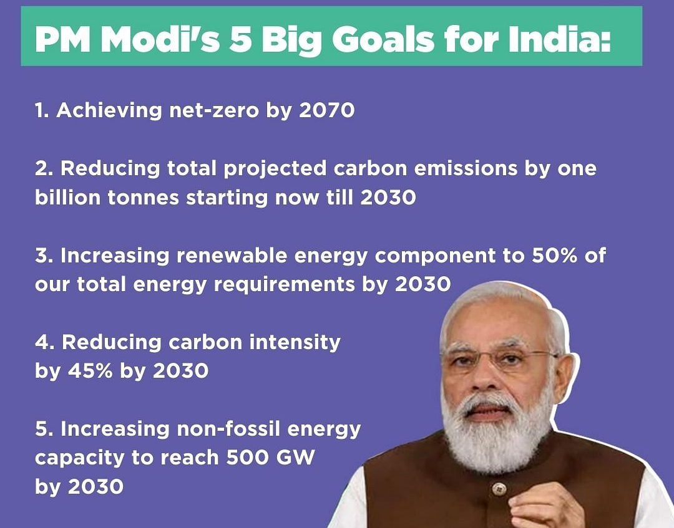

Slide 5
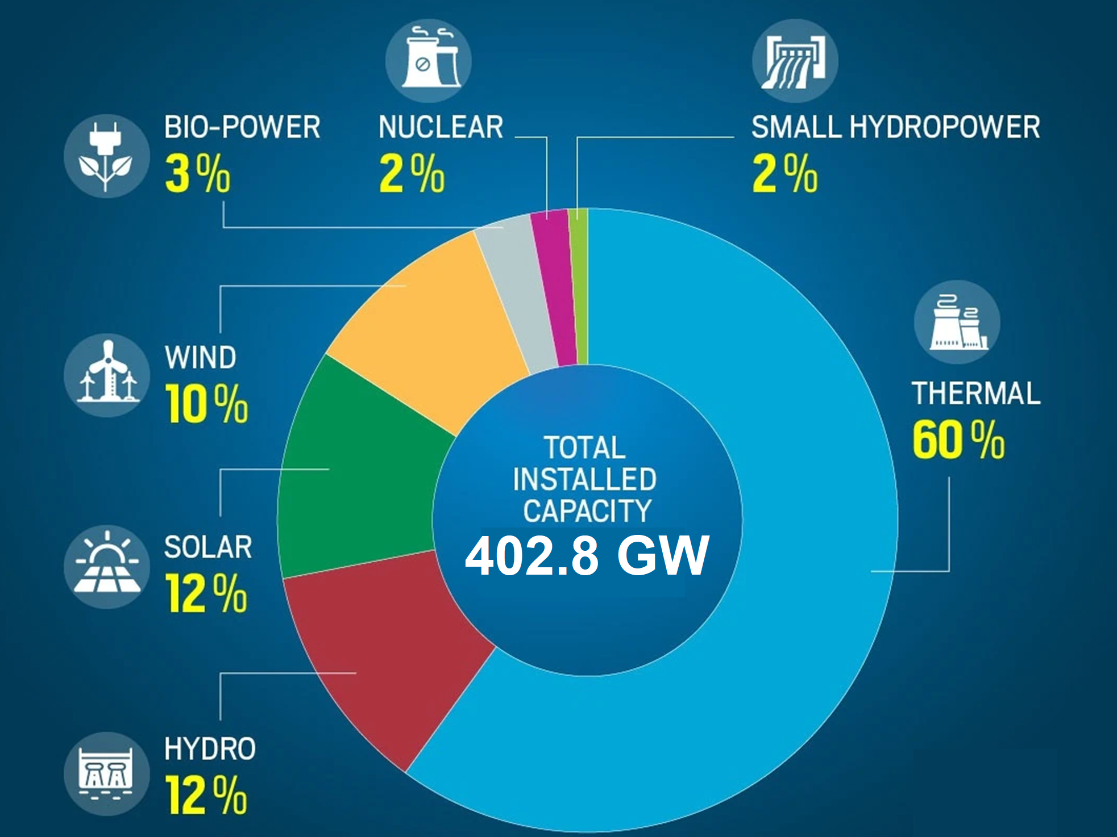
India’s Energy Mix

Slide 6
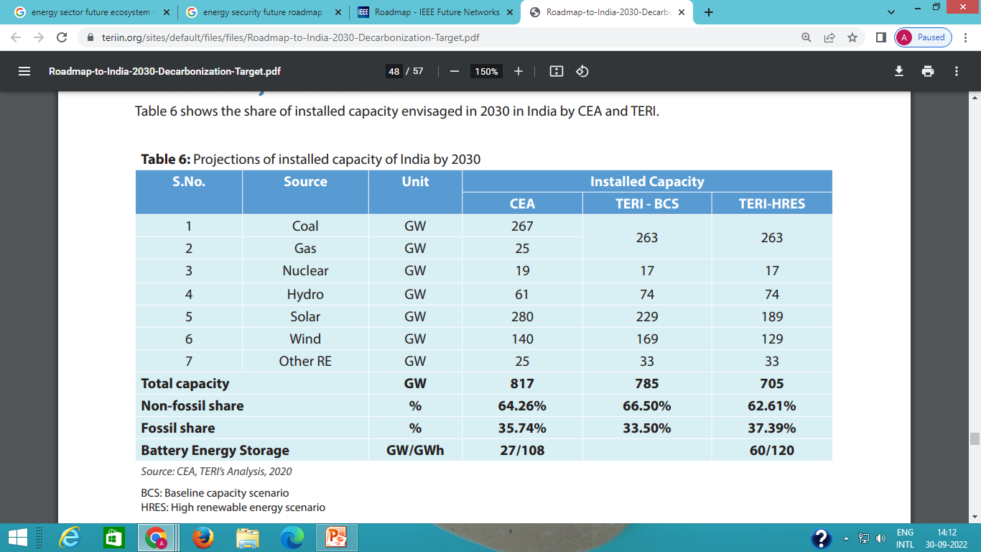
Projections of installed capacity of India by 2030
Notes:
TERI

Slide 7
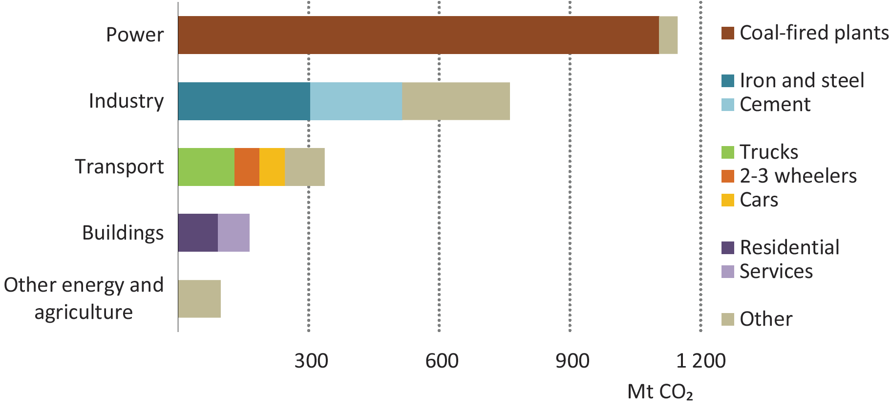
CO2 EMISSIONS FROM THE INDIAN ENERGY SECTOR
India’s power sector is the largest contributor to its CO2 emissions, and coal-fired power plants are responsible for the great majority of power sector emissions.

Slide 8
Carbon emissions produced by the transport sector in 2020
In 2020, direct emissions (tailpipe emissions) by the transport sector (excluding international aviation and international shipping) stood at 272 million tones of CO2 (MtCO2).
The road sector, including passenger and freight, dominate transport emissions, accounting for a share of more than 92%.
Source: CEEW

Slide 9
Well to Wheel Emissions (Scenario till 2030)
Energy forecasting conducted by considering two scenarios for the year 2030, one conservative scenario by NITI Aayog and second an aggressive scenario proposed by CEA, which assumes that India is able to meet NDC targets under the Paris agreement of 40% renewables in the electricity mix by 2030.
There is dramatic increase in the Well-to-Wheel efficiency in the Battery-EV for the 2030 aggressive scenario, as the electricity mix consists of 40% renewables.
For the same reason, the plug-in series hybrids shows the highest Well-to-Wheel efficiencies for this scenario, with the diesel-powered plug-in hybrid showing the highest efficiency.
Source: IISc

Slide 10
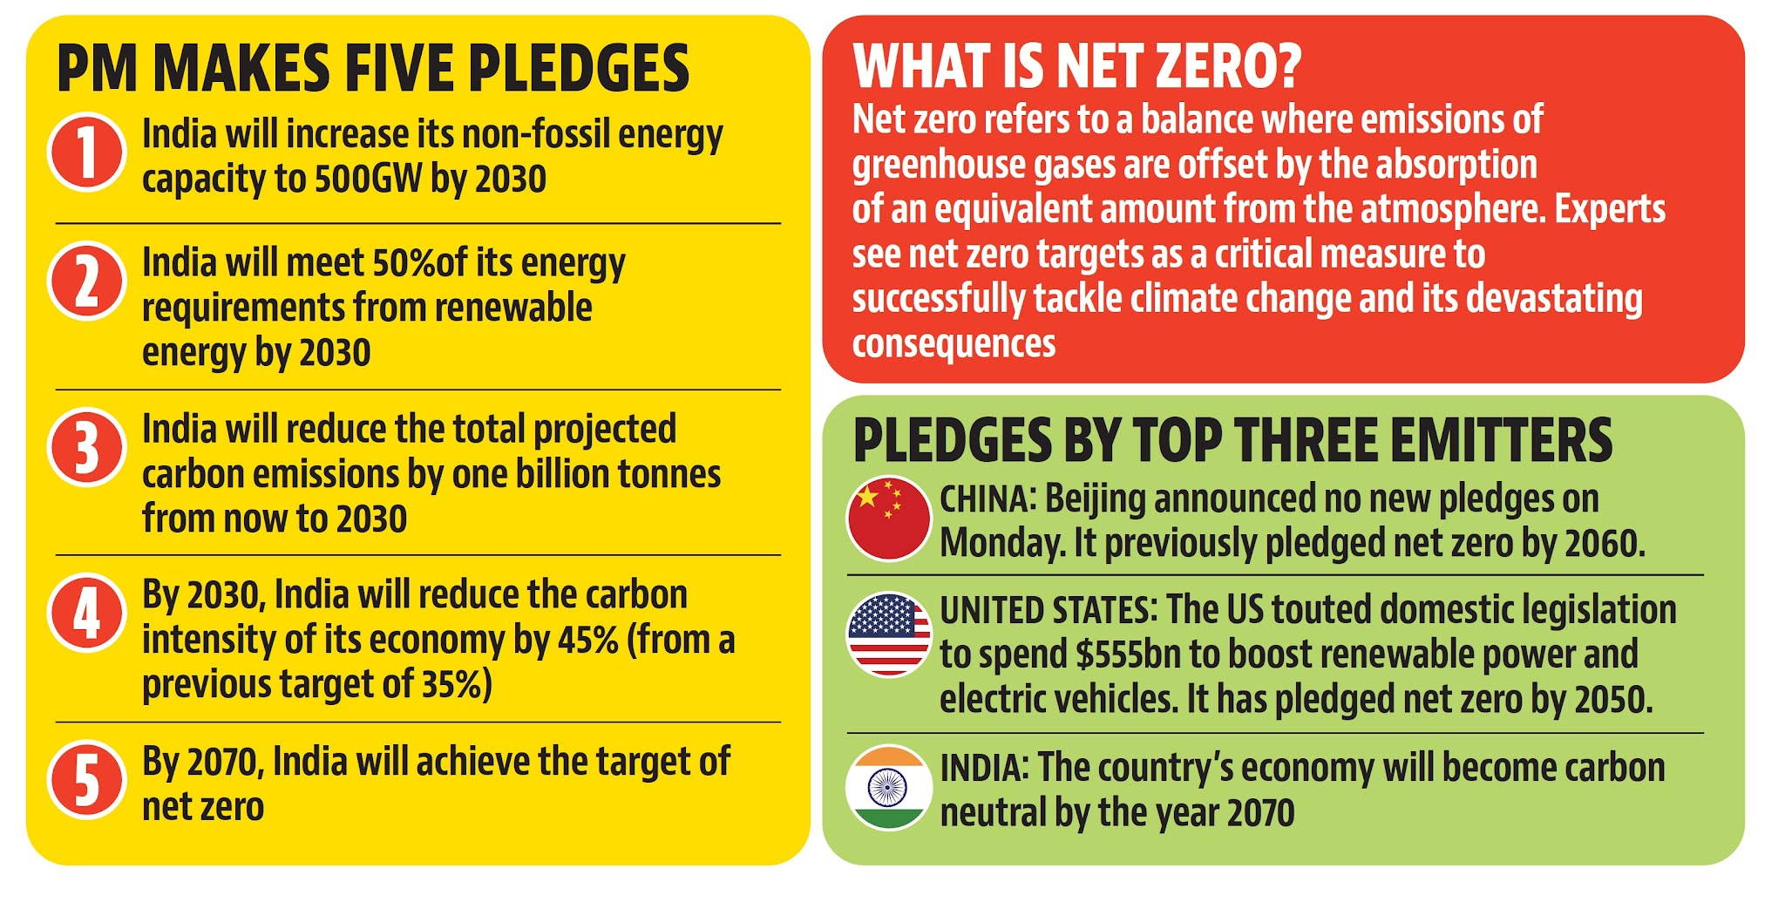

Slide 11
ENERGY EMISSIONS AND NET ZERO MISSION
“India is known to have limited contributions to GHG inventories historically and has very pressing growth imperatives. The country is growing through rapid urbanisation and industrialisation, leading to growing demands for energy. India is aiming to nearly quadruple its economy from around $2.75 trillion today to about $10 trillion by 2030.
The energy sector accounts for ~40 per cent of the GHG emissions of the world’s fourth-largest emitter of carbon emissions. India’s energy generation depends on fossil fuel (59.8 per cent), with coal alone contributing to 51.7 per cent and renewable energy contributing to 38.5 per cent.

Slide 12
ENERGY EMISSIONS AND NET ZERO MISSION
“Estimates show that in order to achieve Net Zero in 2070, installed power capacity on solar should increase to 5,630 GW, use of coal needs to peak by 2040 and go down by 99% between the years 2040 and 2060, and crude oil consumption should peak by 2050,”
The success of interventions will depend on the availability of finances.
“Some estimates are now available. For example, the Centre for Energy Finance estimates that for achieving net zero, India will need about $10 trillion (Rs 700 lakh crore),”.
“About $8.4 trillion will be to scale up renewable energy generation and relevant infrastructure; and about $1.5 trillion for setting up green hydrogen production for industrial decarbonisation.”

Slide 13
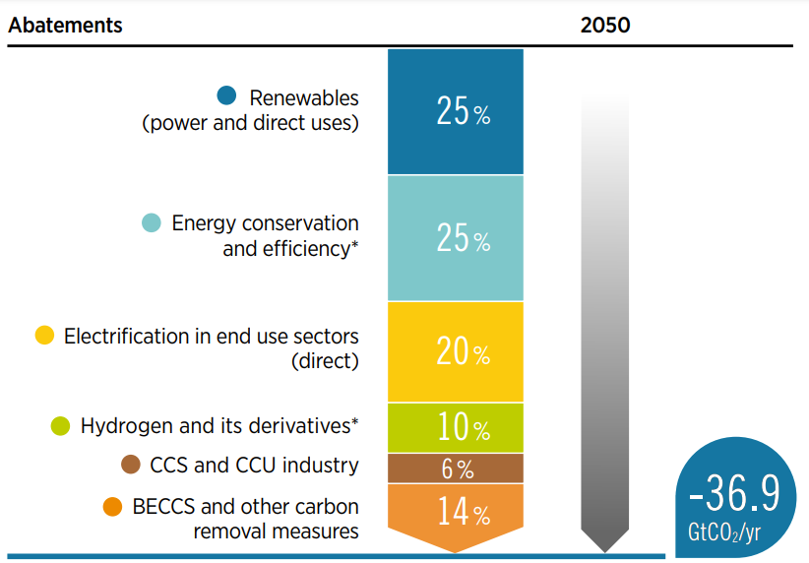
Carbon emissions abatements under 1.5°C Scenario (%)

Slide 14
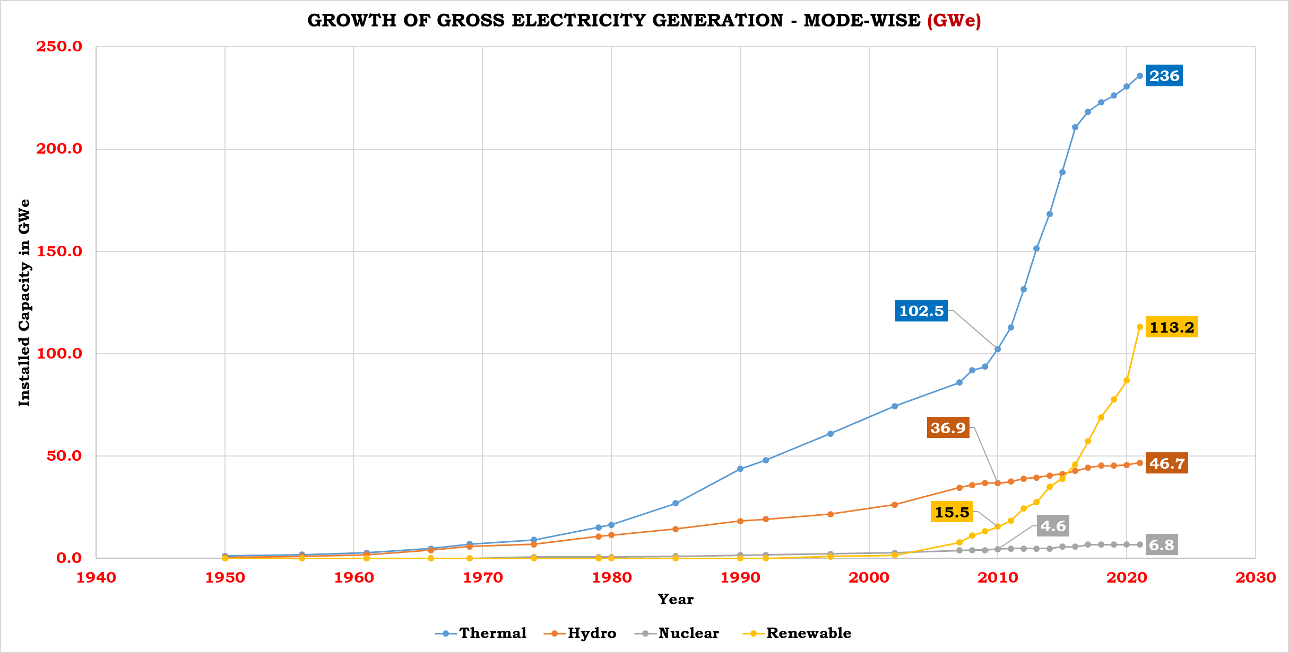
India’s Energy Transition

Slide 15
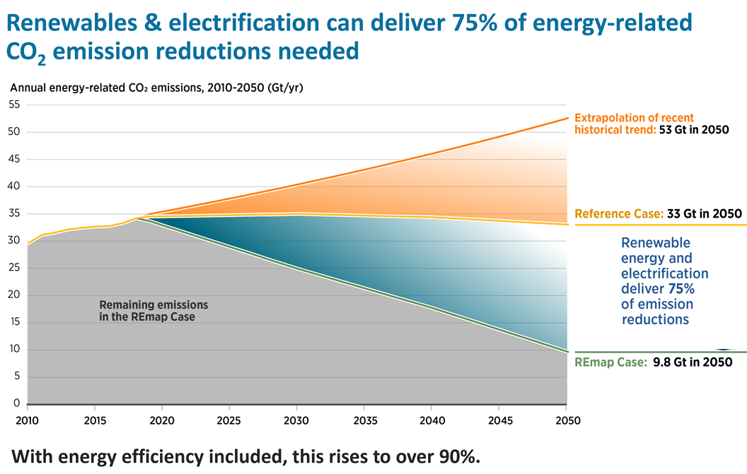

Slide 16
GHG EMISSIONS CONTROL IN AGRICULTURE
Increase adoption of sustainable farming practices to decrease GHG emissions from agriculture – prevent overuse of fertilizers and improve nutrient management to reduce N2O emissions, lower CH4 emissions from rice cultivation through better water management
Use feed additives and high-quality feeds like grains, with support from improved breeding practices to reduce CH 4emissions from ruminant livestock like cows, goats, sheep
Enhance natural carbon sinks by restoring and rewetting peat land, adopting multi-layered farming approaches like shade coffee, implementing grazing practices that stimulate grass productivity and root growth to allow accumulation of soil organic matter

Slide 17
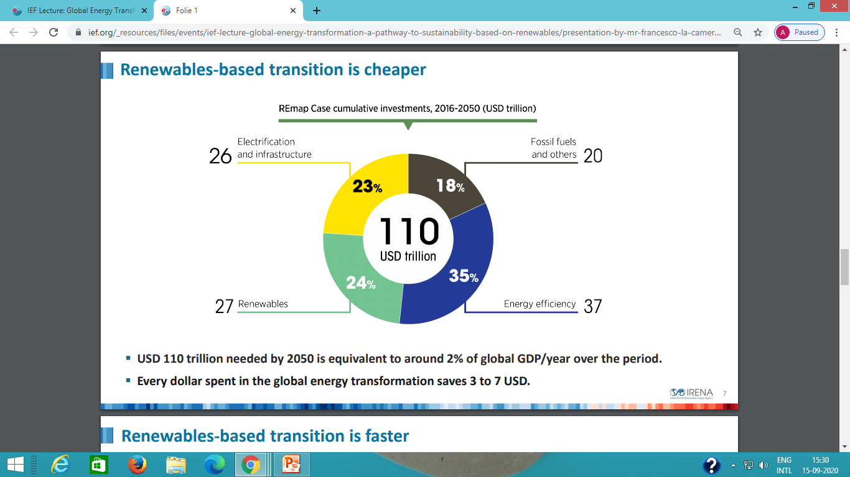
Renewable based transition is cheaper

Slide 18
Efforts needed for Transforming Energy in India
Power Transport Industry Fuel Supply Energy Buildings Integration
 | Bio Energy Solar PV | Electric Vehicles Rail |  |  | Energy Storage | Data Centres & Networks Lighting
 | Hydro Power Natural Gas Fired Power Nuclear Power Offshore Wind Onshore Wind Renewable Power | Aviation International Shipping Trucks & Buses | Aluminium Cement Chemicals Iron & Steel Pulp & Paper |  | Demand Response Hydrogen Smart Grids | Appliances & Equipment Cooling
 | CCUS in Power Coal fired Power Concentrating Solar Power Geothermal Ocean | Fuel Economy Transport Biofuels | CCUS in Industry & Transformation | Flaring emissions Methane emissions from Oil & Gas |  | Building Envelopes Heat Pumps Heating
ON TRACK
MORE EFFORTS REQUIRED
NOT ON TRACK

Slide 19
Towards Clean Energy Transition
India is walking on a tight rope as it tries to balance - meeting energy security for its 1.4 billion population and at the same time contributing to global efforts to reduce GHG emissions. Following path is being followed for a clean energy transition:
National coal gasification mission to gasify 100 MT of coal using clean coal technology
To curb CO2 emissions from industries (power, steel, cement etc.), setting up Carbon Capture Utilization and Storage (CCUS) to lower the footprint.
Utilizing captured CO2 for green methanol production, aggregate production, graphene etc.
National Green Hydrogen Mission
Introduction of BS VI fuel , renewable fuels and infrastructure for energy and fuel distribution for energy transition in transport sector.
As India is traversing its energy transition journey, its success story would be written in the annals of history and would serve as a source of inspiration for clean energy transition all over the world

Slide 20
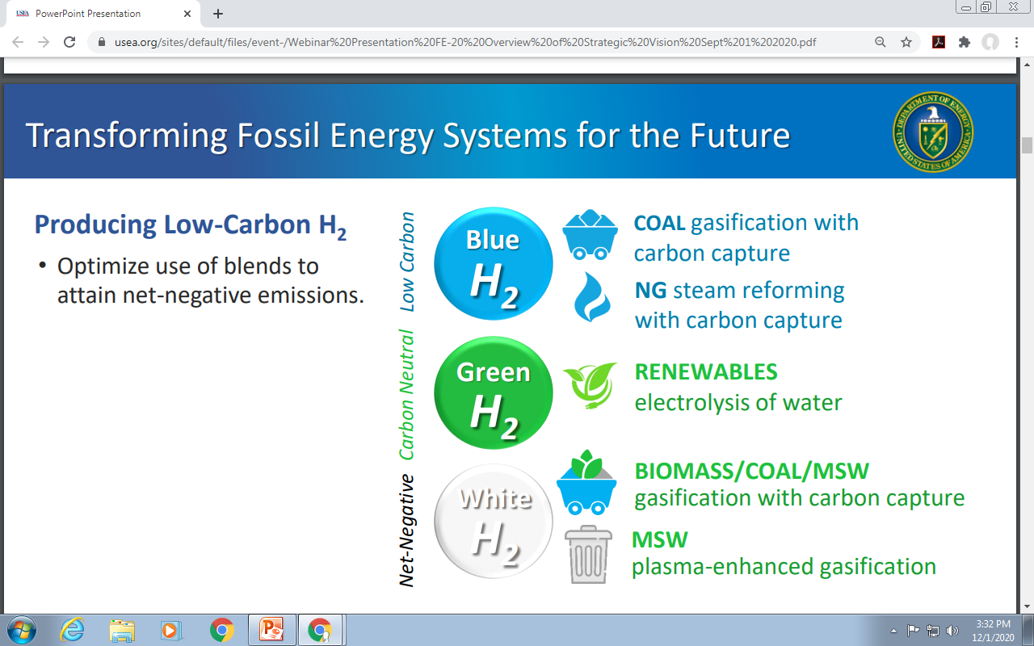
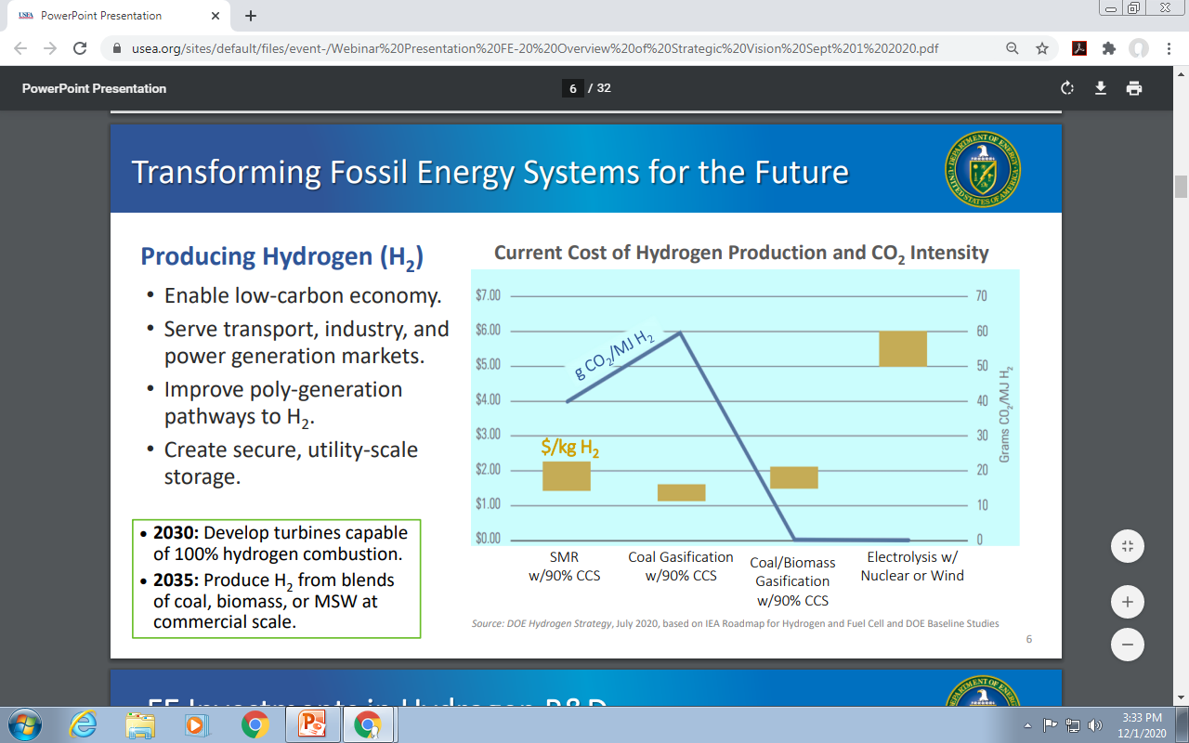
Transforming Coal for the Future

Slide 21
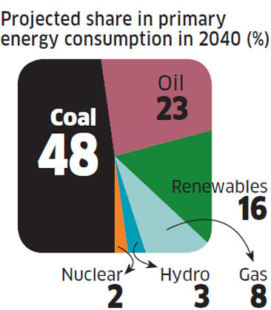
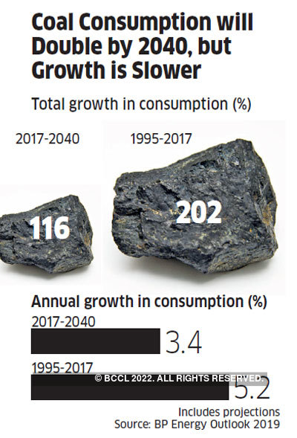
Coal as a Major Source of Energy Mix
Estimates of coal demand projections for 2030
Sector | 2030
Utility electricity generation (MT) | 800 – 875
Industrial demand (MT) | 262- 310
Captive electricity generation (MT) | 130 – 140
Total (MT) | 1192-1325

Slide 22
PRODUCTS FROM COAL, COAL RESOURCES, ASH, & BY PRODUCTS

Slide 23
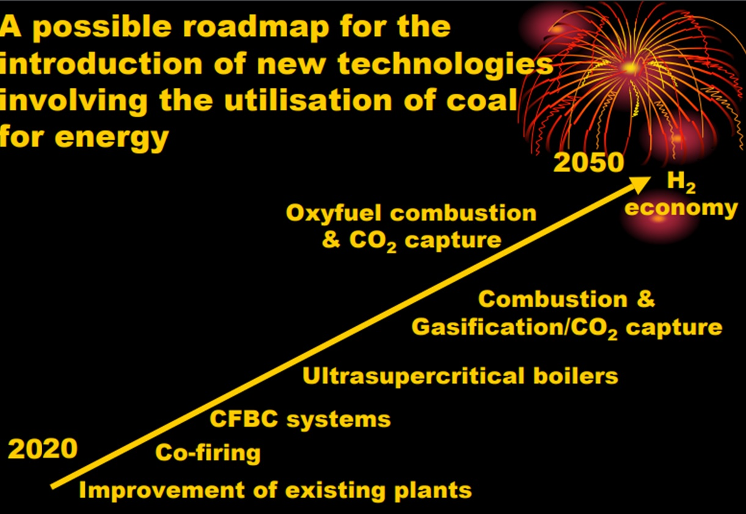

Slide 24
Fossil fuel-based hydrogen as a transition option
Blue hydrogen has been proposed as a bridging solution as the cost of producing hydrogen from renewable power decreases.
One option is the production of hydrogen from fossil fuels with CO2 capture and storage (CCS), so called blue hydrogen.
  Hydrogen from steam methane reforming (SMR) has an emission factor of around 285 grams of CO₂ per kilowatt-hour (kWh)
  Coal gasification has an emission factor of around 675 grams of CO₂ per kilowatt of hydrogen

Slide 25
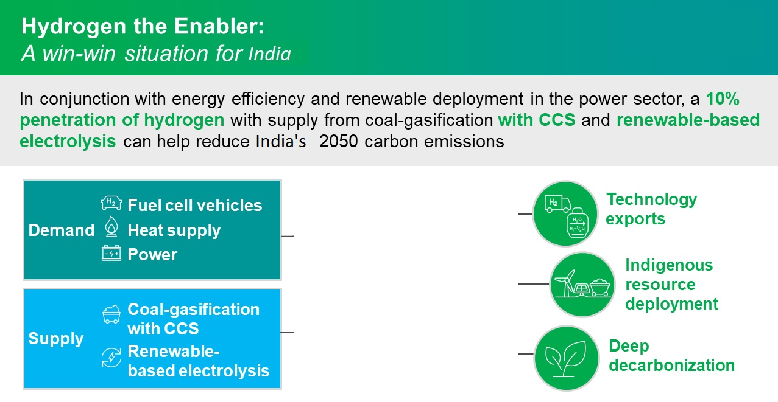

H2

Slide 26
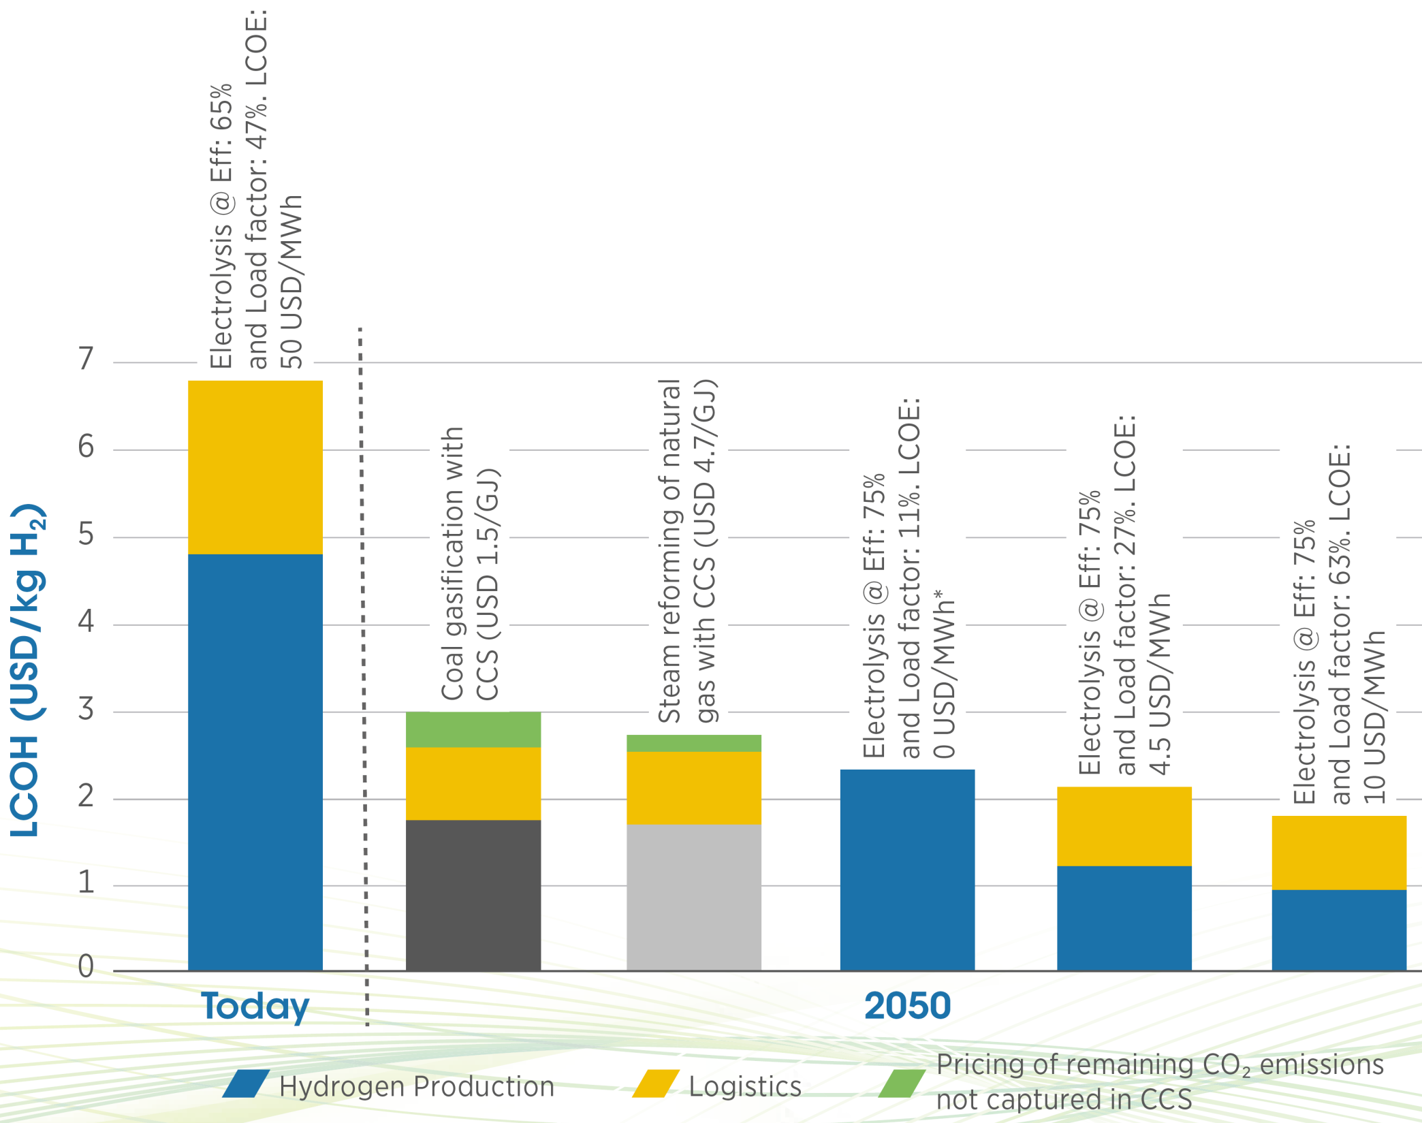
Coal Gasification as Precursor of Hydrogen Economy
For advanced natural gas reforming, costs would increase by 13%, while for hydrogen from coal gasification, costs would decrease by 11% by 2050.

Slide 27
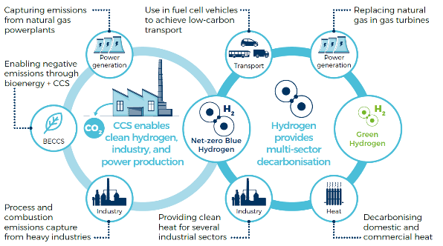
New studies show the role of hydrogen and CCS in reaching net-zero targets

Slide 28
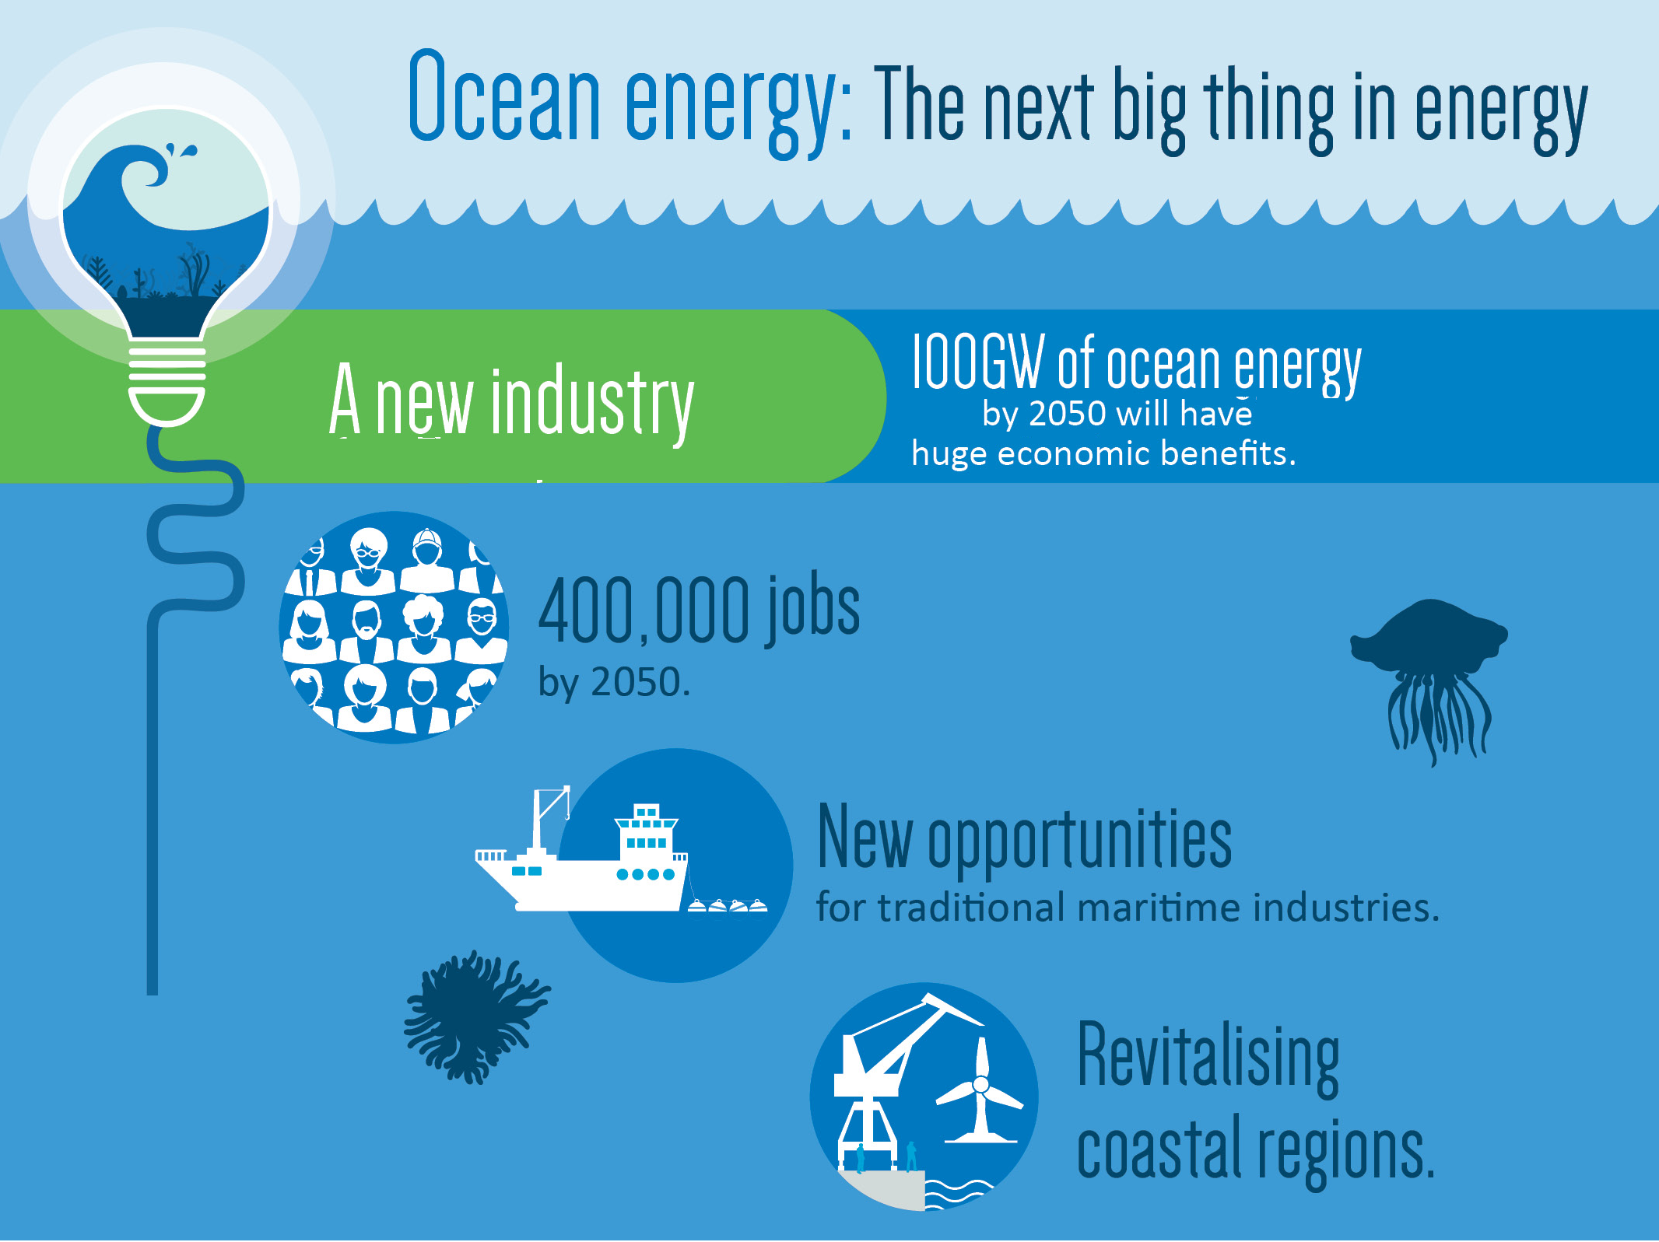

Slide 29
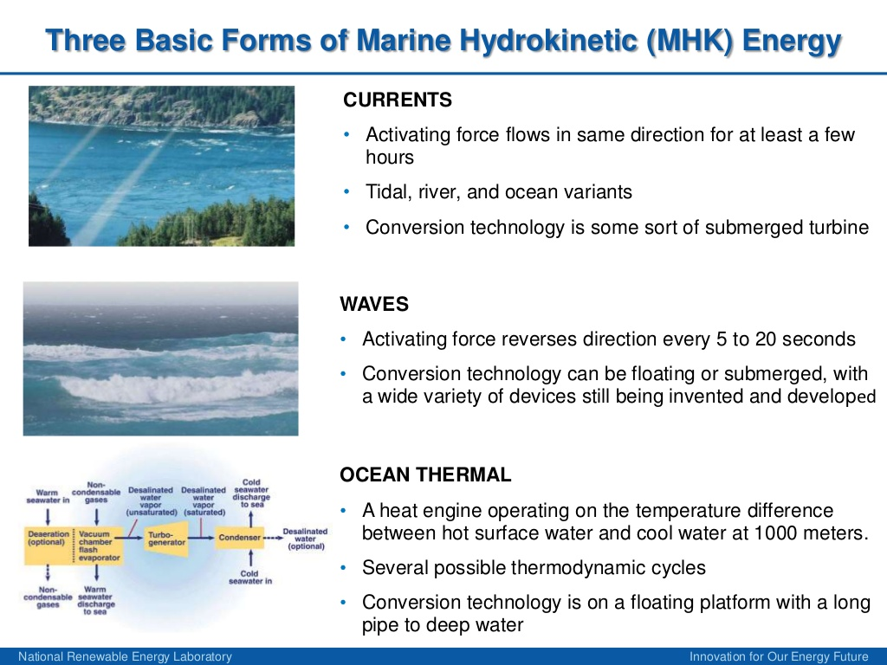

Slide 30
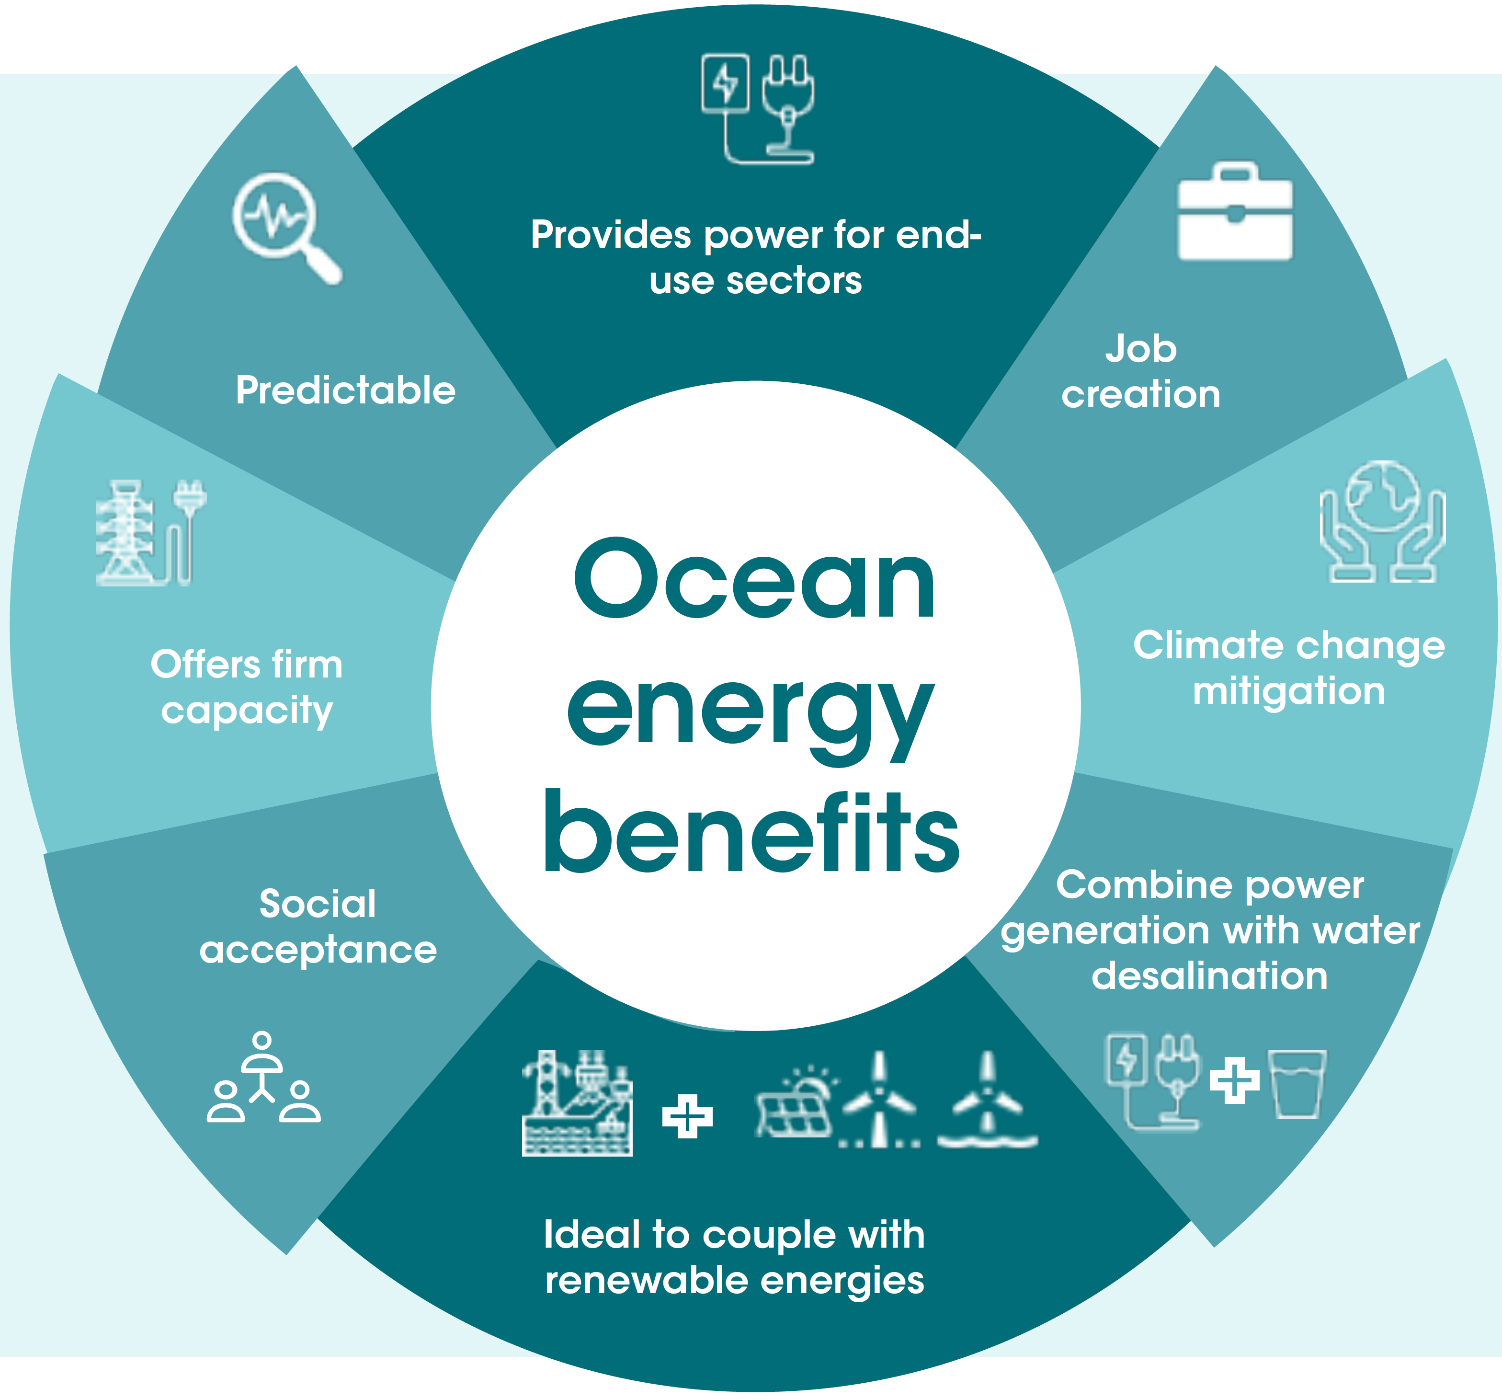

Slide 31










Methanol – A way towards achieving Net Zero
WHY OPT METHANOL FUEL
DME : METHANOL DERIVED FUEL
IT'S A LOW-EMISSION FUEL
VERSATILE FUEL : BLENDED WITH DIESEL AND LPG
IT'S USED IN VEHICLES WORLDWIDE
SMOKELESS COMBUSTION
IMPROVED FUEL ECONOMY
EFFICIENT AND ECONOMICAL THAN IMPORTED LPG
ECONOMICAL THAN PETROL
METHANOL IS AN ENVIRONMENT
FRIENDLY FUEL
NON CARCINOGENIC AND SAFE TO USE
How to Use Methanol
15% Methanol Blended Petrol (M15)
85% Methanol Blended Petrol (M85)
100% Methanol Fuel (M100)
15% Methanol blended Diesel (MD95)
Di-Methyl Ether (DME) blended LPG
Methanol as Hydrogen Carrier

Slide 32
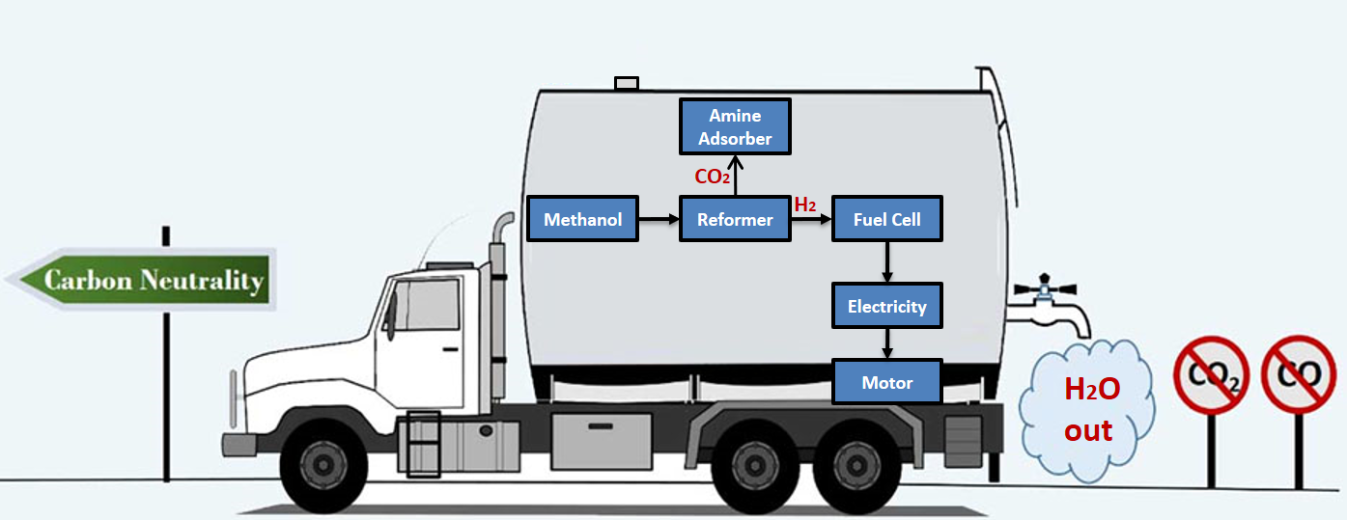
Methanol driven e-mobility for Trucks
Methanol Reformer (Methanol plus Water reacted to make Hydrogen) has several advantages
Lowest CapEx due to low temperature reforming
Lowest Total Cost of Ownership (TCO), with cost of Hydrogen produced about US$3-4/kg
No Supporting infrastructure required for onboarding Methanol Reformer on vehicles
No stored high-pressure H2 required, improved safety

Slide 33
Methanol driven e-mobility for Trucks
Space Required on Heavy Duty Truck for 1,000 km Range
Engine Bay and majority of area under cab available for 80 kW fuel cell system.
Methanol Reformer fits between rails where driveshaft previously took space
Two 550 liter side tanks
600 liters methanol needed for 1,000 km range
Back of cab could also be used for setting up Methanol Reformer
Impractical to fit enough compressed Hydrogen tanks onboard a Heavy Duty truck to store 65 kg of Hydrogen to achieve 1,000 km range

Slide 34
Sustainable Aviation Fuel (SAF) in India
It is estimated by the Indian SAF community, that 100 million domestic passengers in India will be transported on SAF by 2030 on a 10% blend, which translates to 360,000 metric tons of SAF.
India’s total expected domestic need for jet fuel is estimated to be approximately 8 million tons by 2030, flying an estimated 190 million domestic passengers a year.
India has a wealth of natural resources and biobased feedstocks and it is already a low-cost producer of solar and wind power at a global scale.
The nation is well placed to become a global leader in biofuels and e-fuels and to stay ahead of the curve in global technology development.
SAF industry in India could not only help address the threat of climate change but also approximately $2.8 billion in macroeconomic benefits to India’s annual GDP.

Slide 35
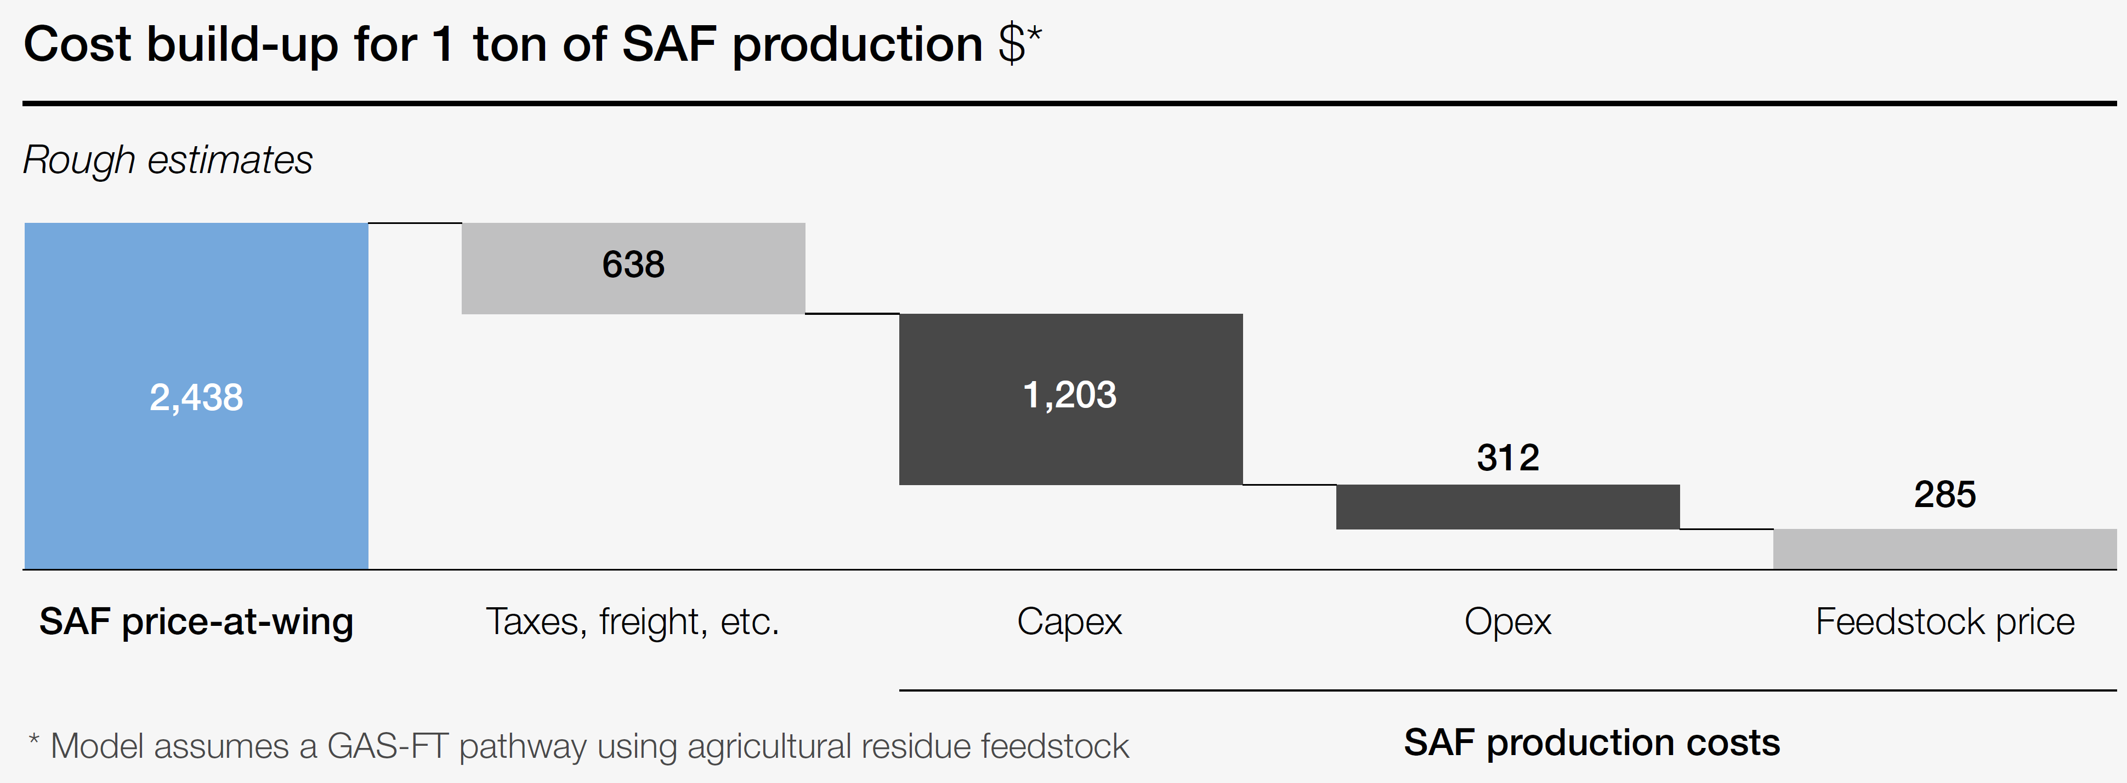
Scale up of SAF can create a value chain with inherent incentives for farmers to encourage reduced stubble burning…
Farmers can receive an additional stable income from selling agricultural residues as feedstock to SAF production
Additional income is in the order of magnitude of 15% to farmers
Significant air quality co-benefits exist, as residues are harvested instead of STUBBLE BURNING

Slide 36
What is nuclear power’s role in the energy transition?
Nuclear energy does not require burning fossil fuels, it does not directly contribute to greenhouse gas emissions and climate change — which has led experts to say that it could make the energy transition more feasible.
More advanced reactors could be key to providing cheap and plentiful energy that does not come from fossil fuels.
Companies in Russia, Canada, the U.S., and elsewhere are investing in small modular reactors, which would require less investment than traditional reactors and could be contained on ships, making them relatively mobile.
Proponents of these smaller reactors have claimed that they would be particularly useful for smaller energy purchasers that need a reliable supply, like military bases or remote cities. Rather than replacing aging power plants, the micro reactors would make nuclear power attractive to a broader market.

Slide 37
What is nuclear power’s role in energy transition?
It is easier to stockpile uranium than natural gas, which makes nuclear power somewhat more reliable in extreme weather events than some other sources of energy.
Nuclear energy will feature in the global energy mix for decades to come but its share in the mix and its rate of growth will depend on a number of factors:
        Speed of innovation in new nuclear technology
        Policies on legacy waste management.
        Market design and financing structures
"Nuclear energy is and can be one of the most cost-competitive low-carbon options for generating electricity"
"Lifetime extension of existing reactors is one of the best power generation investments available in the market on the basis of the levelised cost of energy"

Slide 38
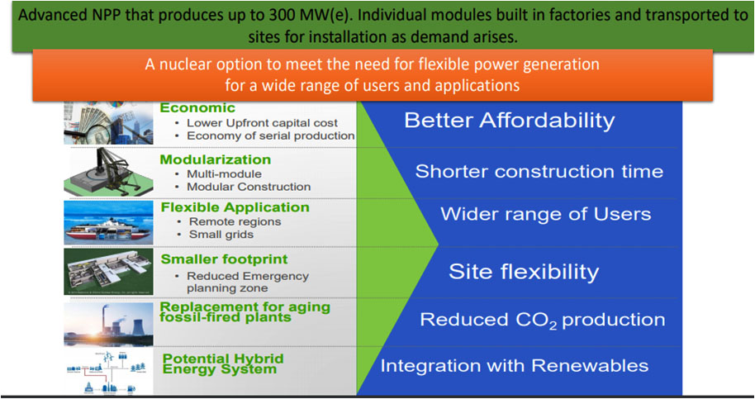
Small Modular Reactors

Slide 39
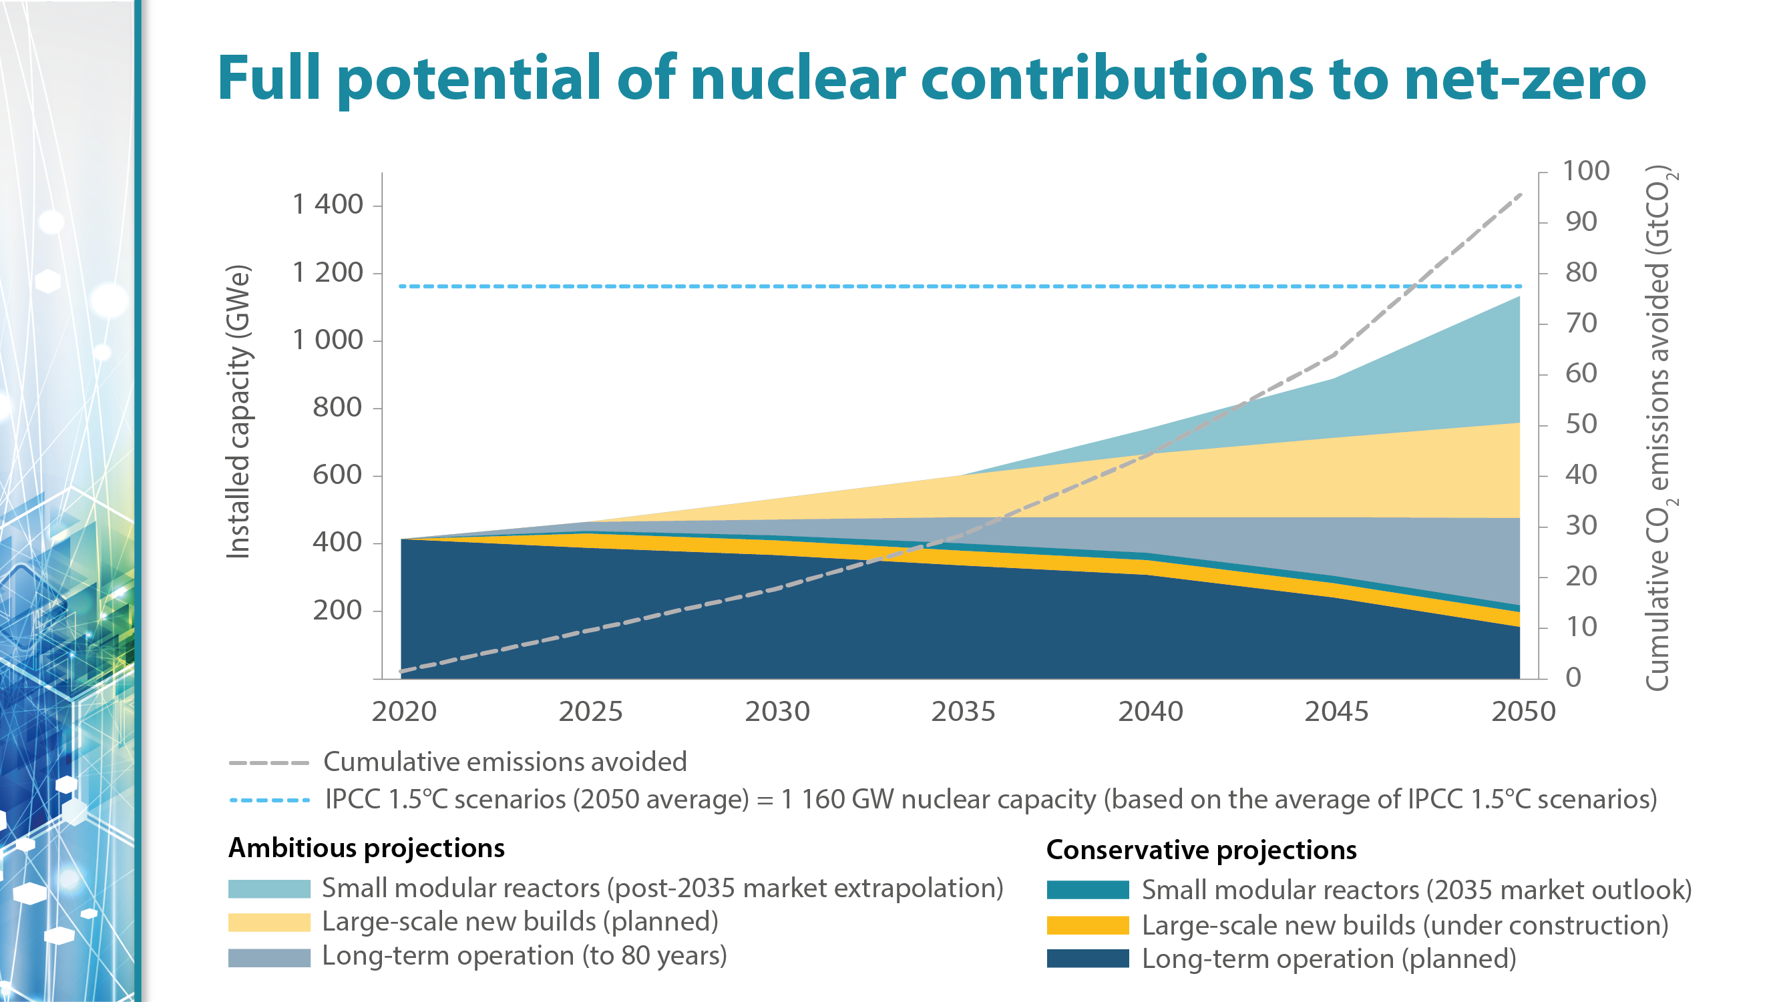
With Conservative approach, installing a nuclear capacity of 400 GWe will avoid cumulative 30 GtCO2
With Ambitious approach, installing a nuclear capacity of 1160 GWe will avoid cumulative 75 GtCO2, which is equivalent to IPCC 1.5 Deg. scenario

Slide 40





Key trends for a Sustainable Energy Future
Access to reliable, affordable and sustainable energy supply is a necessity for economic growth
Ramp up the contribution of the renewable energy for long-term sustainability
Utilize technology for efficient and cleaner use of energy
Embrace emerging and cleaner energy resources like Hydrogen
Digitalization and AI driven technologies will form the core of future proof and efficient transmission system
Access to sustainable, competitive capital will accelerate the energy transformation journey

Slide 41
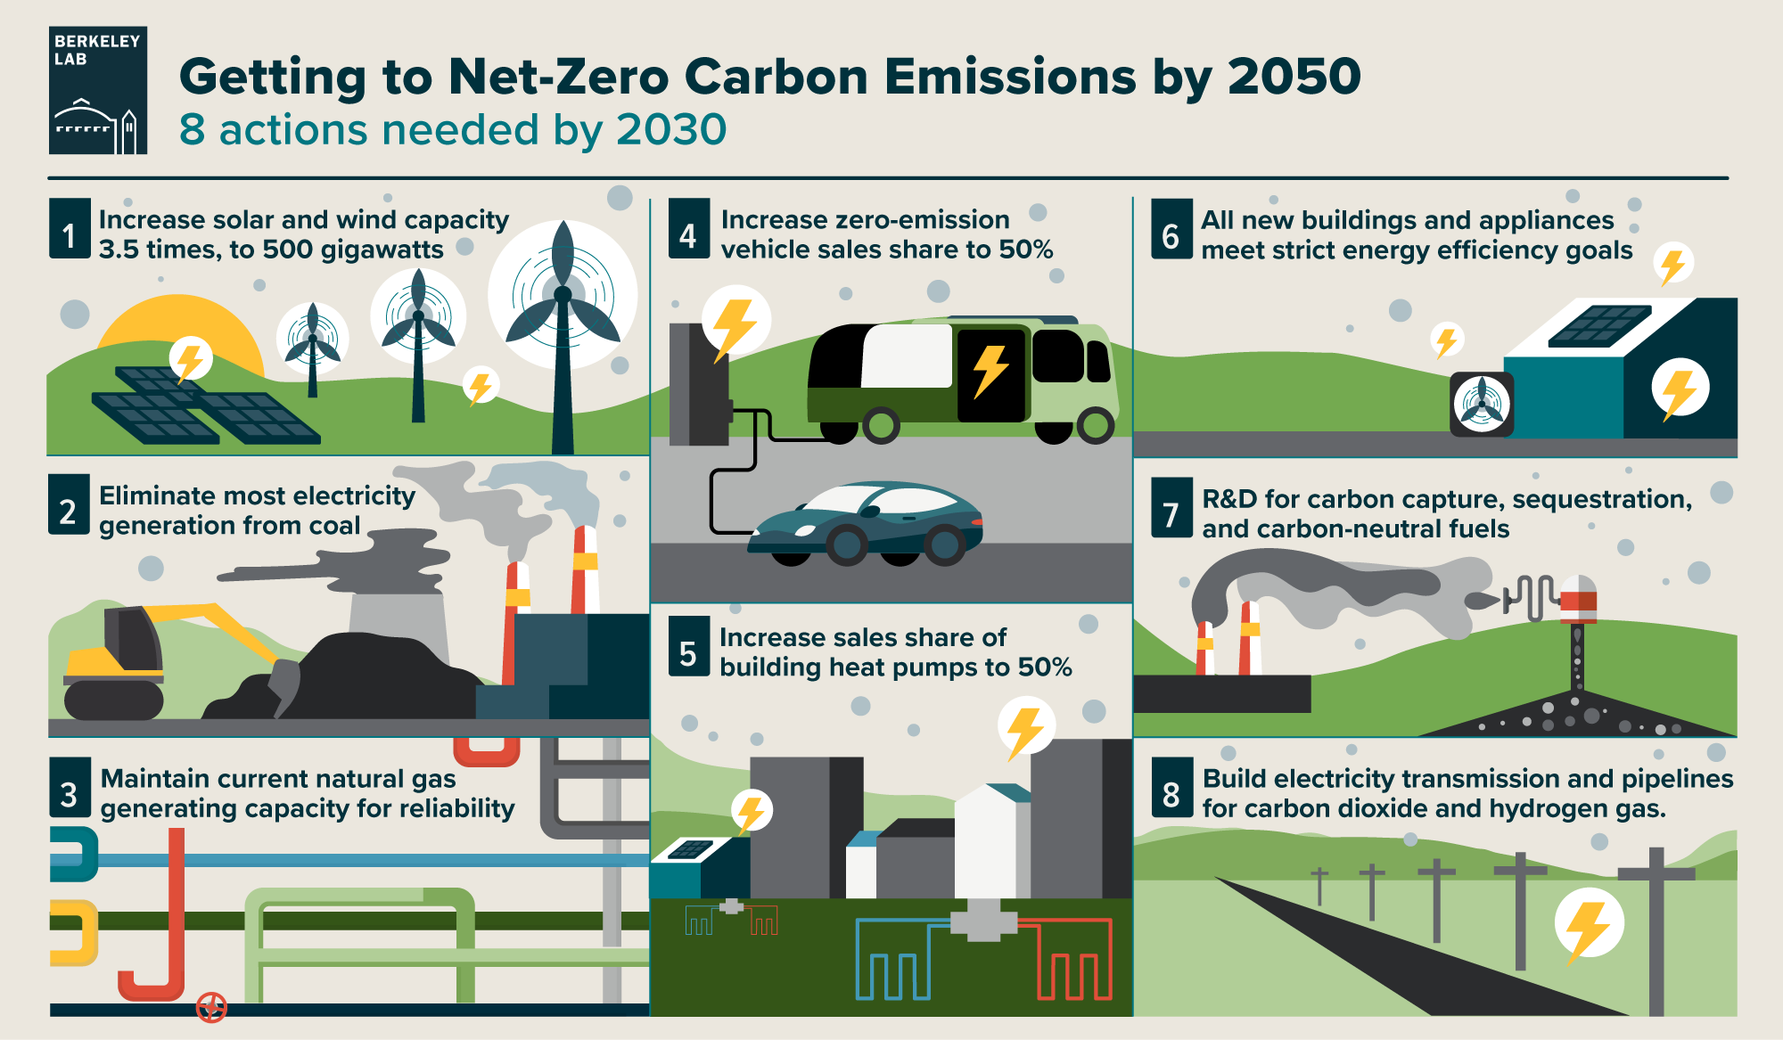
Getting to Net-Zero Carbon Emissions by 2070 (1/2)

Slide 42
Getting to Net-Zero Carbon Emissions by 2070 (2/2)

Slide 43
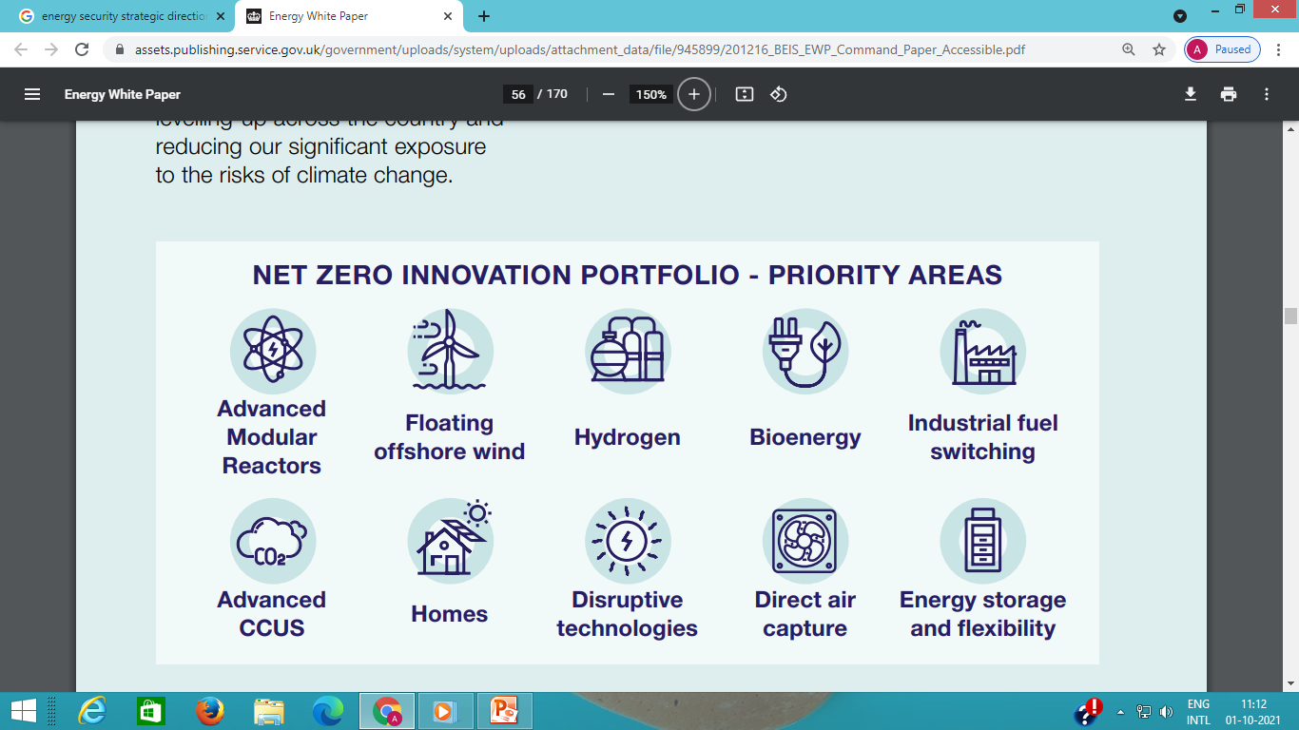

Slide 44
Role of Government in Promoting Net Zero for Sustainable Growth
Governments need to establish regulatory environment to allow CCUS technologies to be deployed at scale and early to establish a new industry sector. CCUS potential to attain net-zero is vast.
Build CO2 transport and storage infrastructure at scale to bring down costs and encourage CCUS uptake by industries. This is something that individual businesses cannot do themselves.
Strengthen the competitiveness of CO2 EOR for the oil and gas industry. Reduce the relative costs of CO2 EOR in comparison to other oil recovery methods (Capex, cost of CO2 and regulations making other production techniques relatively more expensive).
Incentivise CO2 capture from anthropogenic sources. Encourage collaboration between industrial sources of CO2 and users of EOR.

Slide 45
Role of Government in Promoting CCUS for Sustainable Growth
Promote R&D programs and initiatives that can unlock the economic potential of CO2 utilization. Pursue large-scale demonstration for CCUS in industry in national and regional programmes.
Set standards to help industry develop products with CO2 and promote use of products that sink CO2 (e.g. concrete industry).
Introduce financing mechanisms, such as tax credits, carbon prices & taxes, mandate & standards, carbon financing in development countries.

Slide 46
Without energy, there is no economy.
Without climate, there is no environment. Without an economy and environment, there is no material wealth, no civil society, and no personal or national security. And the problem is that we have been getting the energy our economy needs in ways that are wrecking the climate that our environment needs.

Slide 47
Provide incentives to attract investments in indigenizing manufacturing of emerging low-carbon technologies such as water electrolysis and carbon capture to cater to domestic demand as well as establish India as leading regional supplier, as envisaged under “Atmanirbhar Bharat” initiative

Slide 48

Thank You

Slide 58
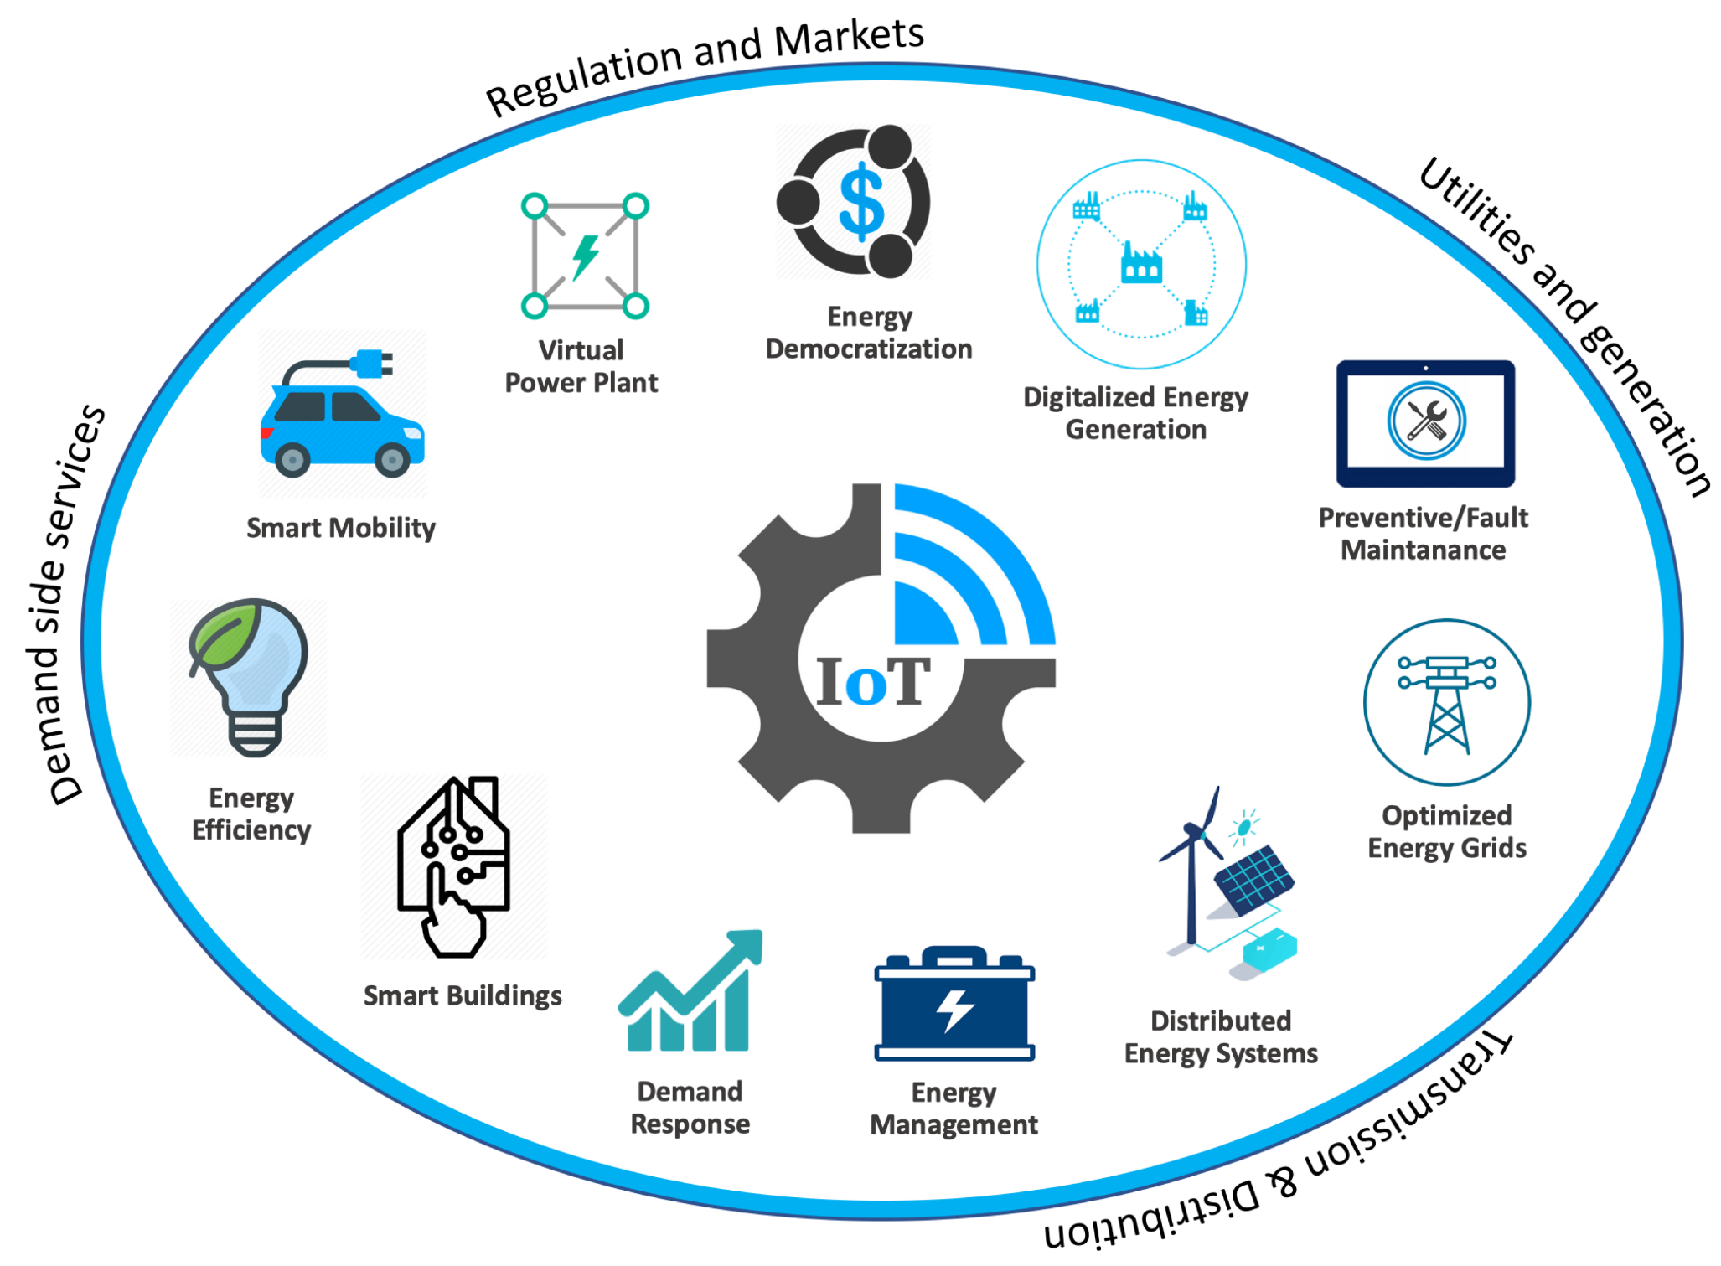
Internet of Things – Application for Energy Systems

Slide 59

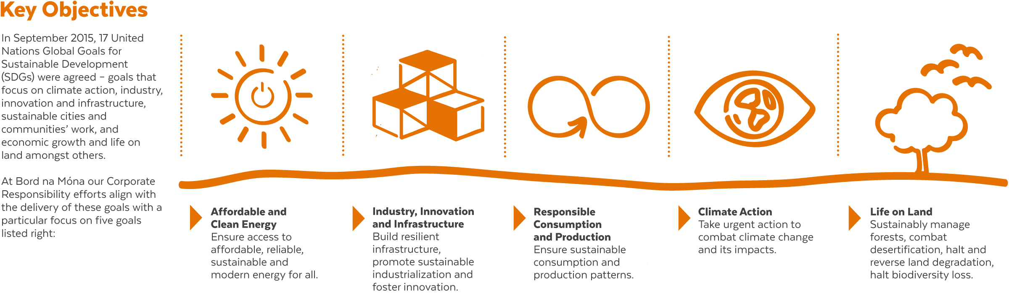
Bioenergy &
SDG 7
Affordable & Clean Energy
SDG 9
Industry, Innovation & Infrastructure
Promote sustainable industrialization
SDG 12
Responsible Consumption & production
Sustainable consumption of energy
SDG 15
Life on Land
Restoration of Biomass
SDG 13
Climate Action
Lifecycle CO2 emissions saving

Slide 60
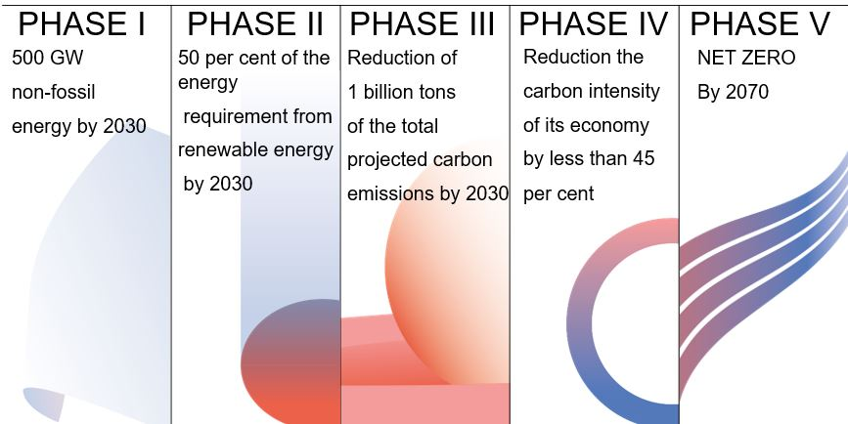
Road Map for Panchamrit
The 5 essential commitments announced by Hon’ble PM Modi, the “Panchamrit” include a step-plan for a greener India. These plans are a massive opportunity for all sectors and for growth of the economy

Slide 61

Progress in energy transition can be measured across six channels
Decarbonizing energy sources
Increasing operational energy efficiency
Identifying new investment priorities
Deploying new technologies
Adjusting to new policy mandates
Managing consumer and shareholder expectations

Slide 62
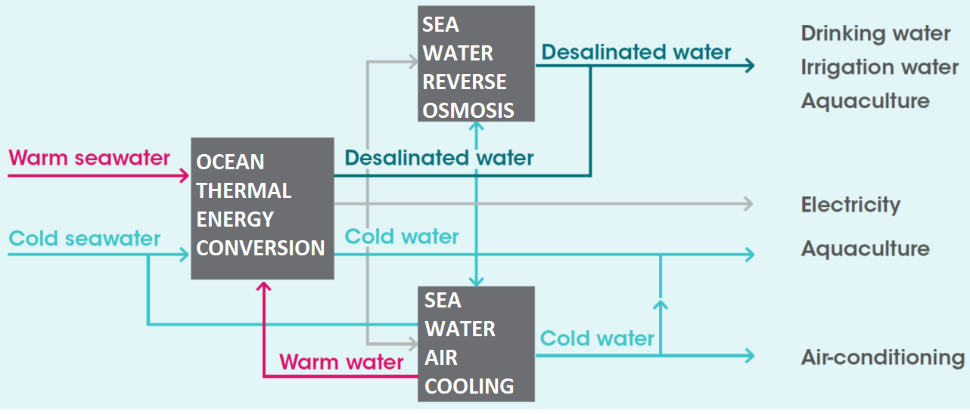
Coupling ocean energy with desalination, cooling, and aquaculture for offshore and islands

Slide 63
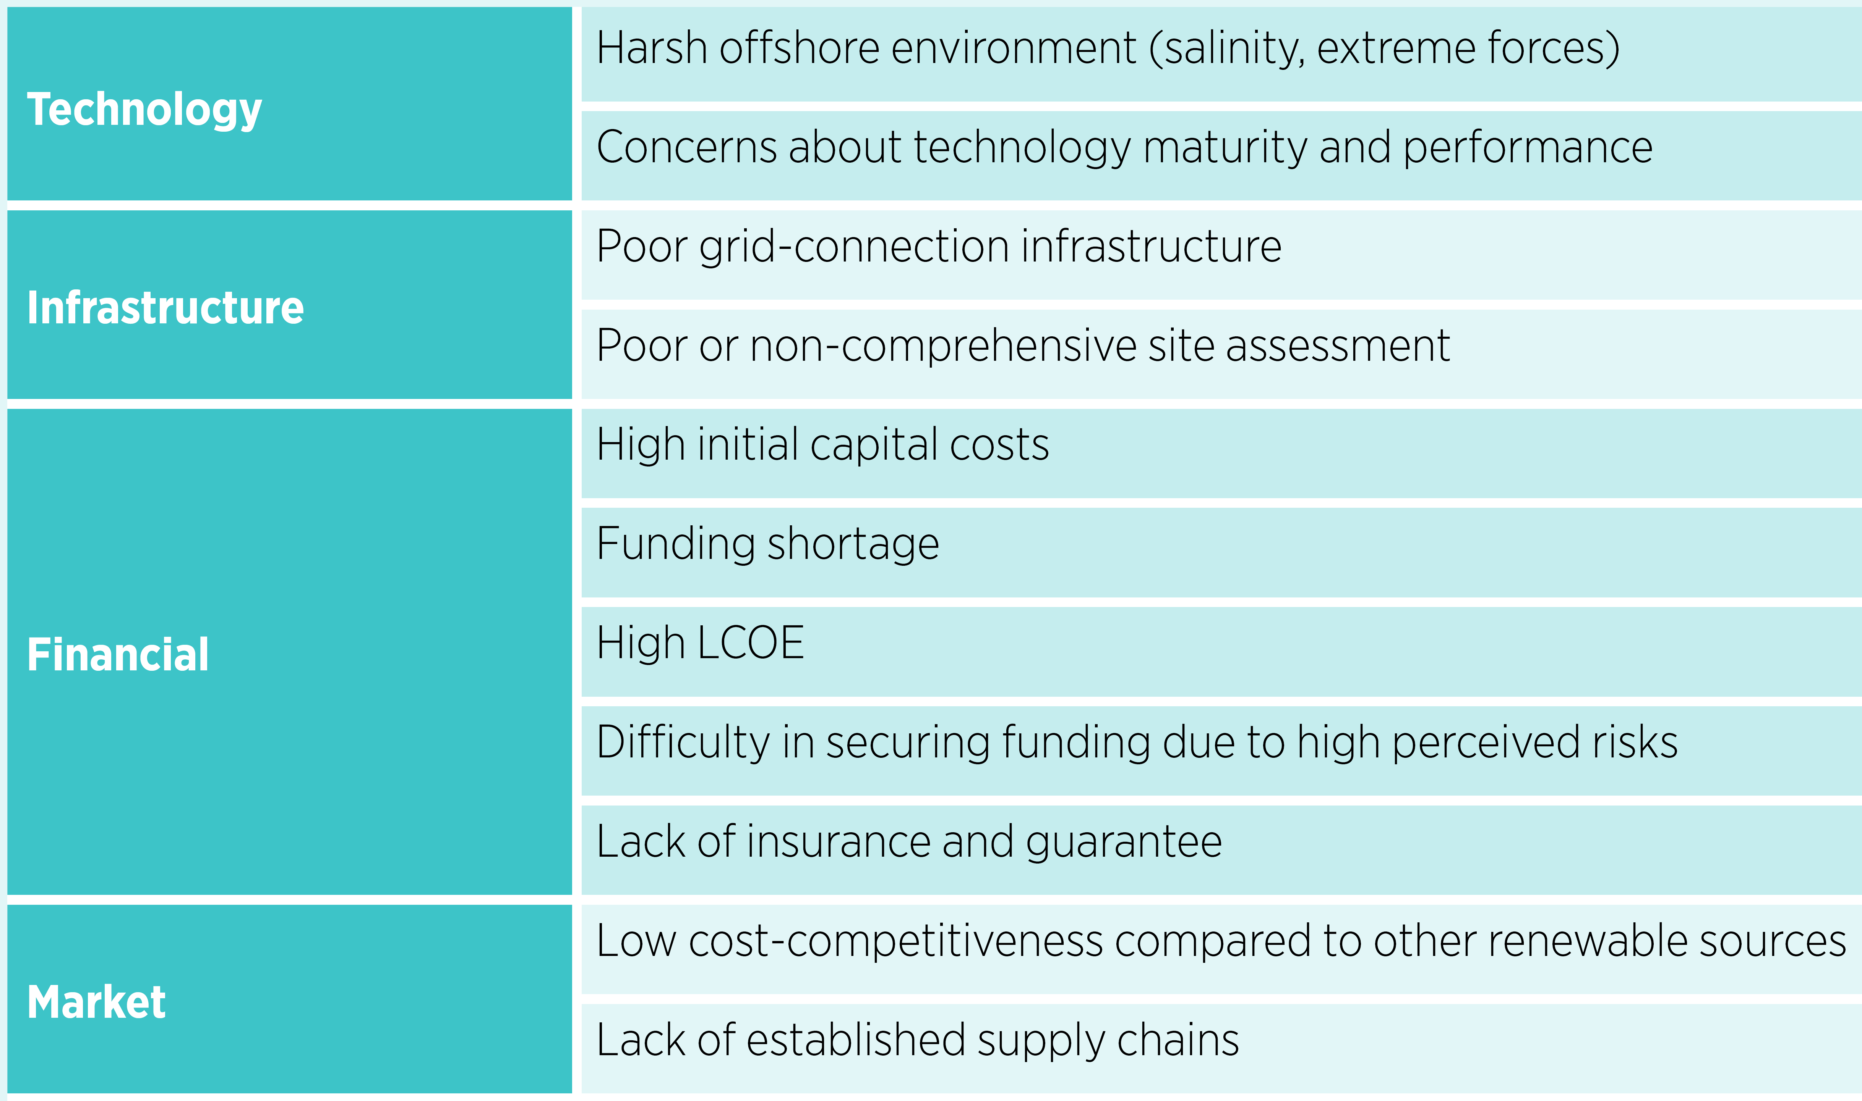
Challenges to overcome in Ocean Energy Sector

Slide 64
India Transport Energy Outlook
With economic development, an exponential increase in four-wheelers will drive the future growth of passenger transport.
The shift to four-wheelers will significantly impact the transport sector’s energy demand and emissions.
With rising income levels, the demand for domestic air travel will continue to increase at a fast pace for the next few decades
The dominance of trucks in India’s freight transport segment means that this transport segment would be the most challenging one for India to tackle from a decarbonisation perspective due to the limited availability of sustainable alternatives.

Slide 65
Nuclear Energy Contributions to Net-Zero
Nuclear is a proven and effective low carbon energy source: Nuclear is a proven low carbon source of energy that reduces greenhouse gas emissions and can replace our current reliance on polluting fossil fuel sources.
Nuclear is available, scalable and deployable: New nuclear needs to be deployed at scale and urgently, along with renewables, in order for Net Zero targets to be achievable.
Nuclear is a flexible and affordable source of clean energy: Nuclear can integrate with an increasing supply of variable renewables to deliver efficient and affordable clean energy systems.
Nuclear can deliver more than just low carbon electricity: Nuclear is also capable of supporting the decarbonisation of other sectors, such as heating and transport.
Nuclear supports inclusive and sustainable global development: Nuclear promotes global socio-economic benefits and is strongly aligned to the UN Sustainable Development Goals.

Slide 66
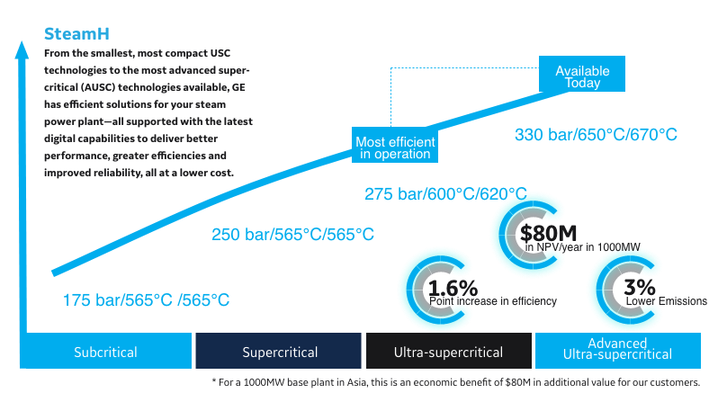
Advanced Ultra-Supercritical Technology

Slide 67
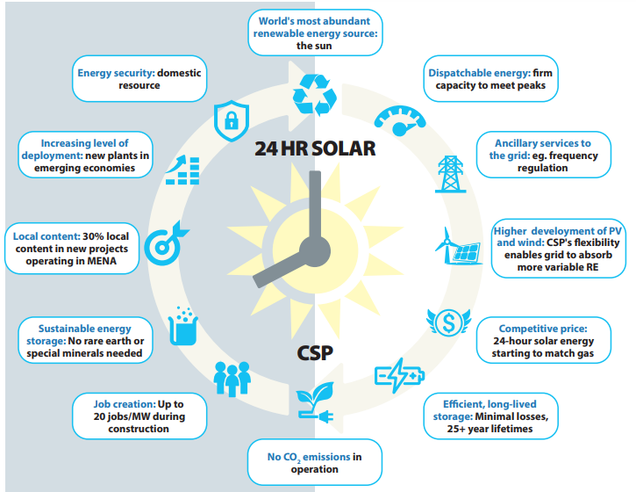
: Key benefits of CSP technology
Notes:
TERI

Slide 68
Action needed now for energy transition (1/3)
The power sector needs to be transformed to accommodate growing shares of variable renewables
Develop power systems that provide a high level of technical flexibility complemented by operational flexibility.
Better market forecast with real-time variable pricing and shorter trading intervals.
Power markets will need to be redesigned to enable the optimal investments for systems with high levels of Variable Renewable Energy and enable sector coupling.
Digitalisation is a key enabler to amplify the energy transformation
Smart innovations can be turned into smart solutions using a range of digital technologies
As the power sector begins to see the share of VRE rise, the overall flexibility of the system will need to increase.

Slide 69
Action needed now for energy transition (2/3)
Accelerating the electrification of the transport and heating sectors is crucial for the next stage of energy transformation
EV charging infrastructure must be supported.
Alternative heating technologies, such as heat pumps in industries should be promoted.
The electricity and end-use sectors must be coupled.
Hydrogen produced from renewable electricity could help to reduce fossil-fuel reliance
It is important to set up a stable and supportive policy framework.
Encourage the appropriate private investments in hydrogen across the entire supply chain (equipment manufacturers, infrastructure operators, vehicle manufacturers, etc.,).
Certification of hydrogen from renewable power should be promoted.

Slide 70
Action needed now for energy transition
Supply chains are key to meet growing demand for sustainable bioenergy
Bioenergy must be produced in ways that are environmentally, socially and economically sustainably.
In sectors such as shipping and long-haul road transport, biofuels might be the main or only option for decarbonisation for years to come.
Targeted attention and specific policies must be devoted to these sectors and to the development of advanced biofuels and their related biofuel supply chains.
Decarbonising the energy system requires swift and decisive policy action
Policy makers need to establish long-term energy planning strategies, define targets and adapt policies and regulations that promote and shape a decarbonised energy system.
Policies should create the right conditions for investments in energy efficiency, renewable energy supply, grids, EV charging, storage etc.
Close co-operation between the public and private sectors will be key.

Slide 72
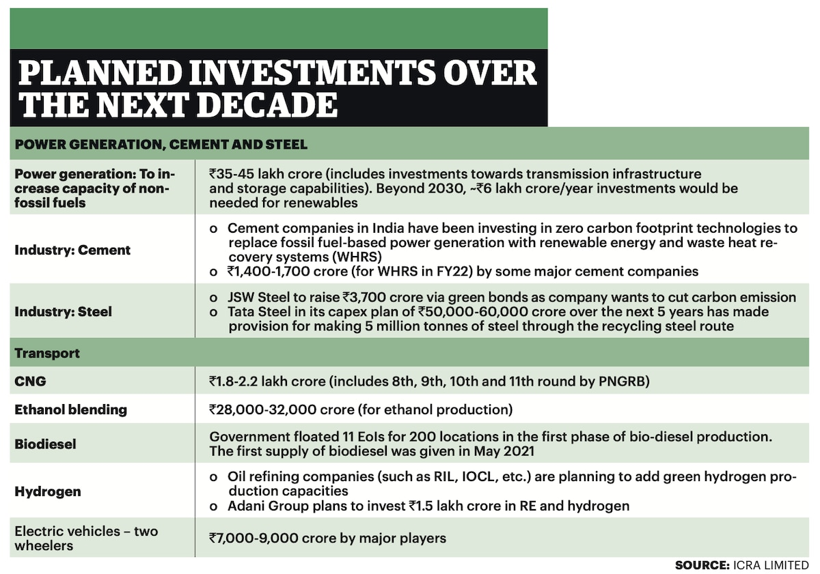

Slide 73
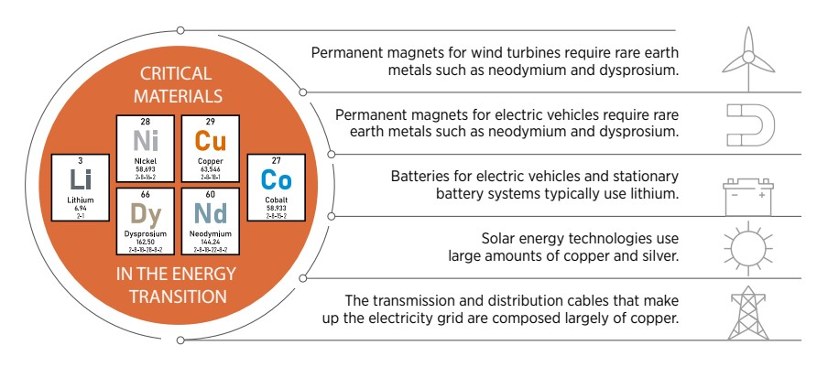
Main technologies increasing demand for critical materials

Slide 74
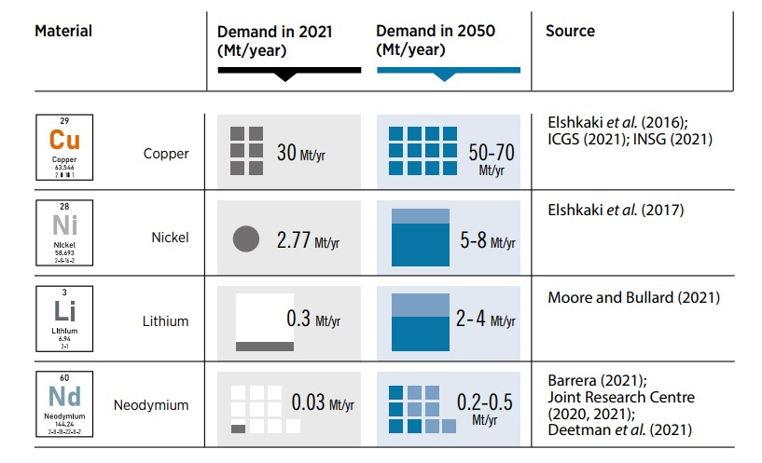
Actual (2021) and projected (2050) demand for copper, nickel, lithium and neodymium under IRENA’s 1.5°C Scenario

Slide 75
Current demand for hydrogen in India:
Industry sectors such as refineries and fertilizers account for major hydrogen demand in India mainly through grey hydrogen.
Grey hydrogen is largely produced by natural gas therefore, emitting huge amount of CO2 emissions.
Hydrogen can be useful in application that require high temperatures (above 250 degrees Celsius), especially in the chemical, iron and steel industry. In such cases, hydrogen can serve as an excellent alternative to other energy sources.
Also, it is essential to promote usage of hydrogen in sectors where direct electrification is not feasible.

Slide 76
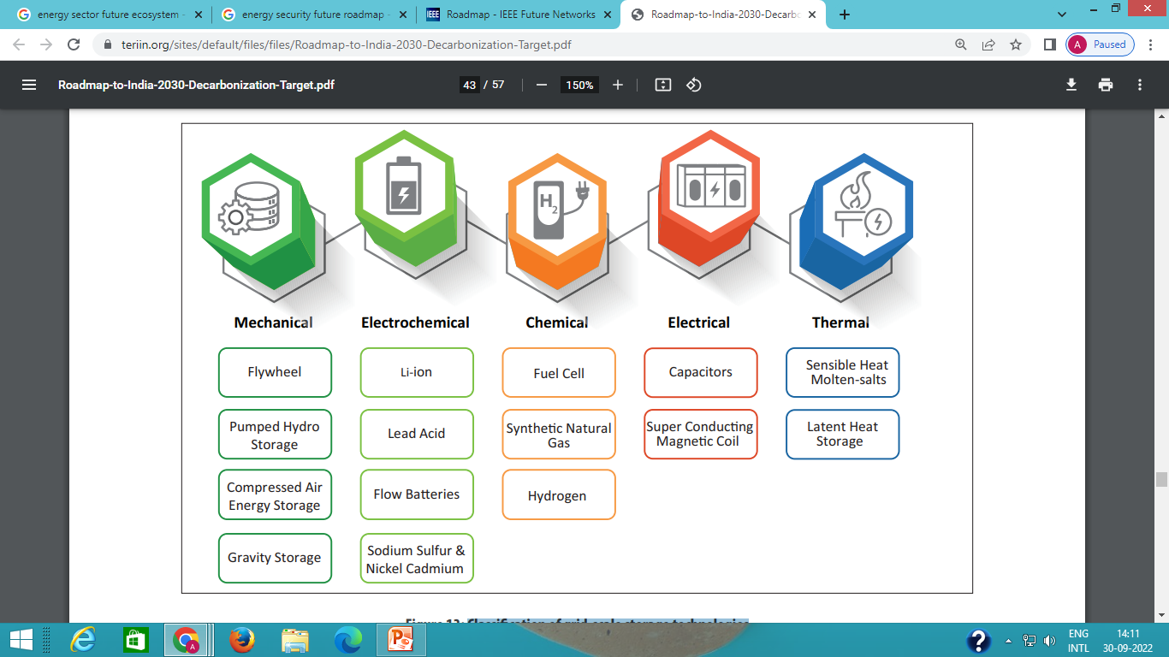
Classification of grid-scale storage technologies
Notes:
TERI

Slide 77
Road Map for Panchamrit
The 5 essential commitments announced by Hon’ble PM Modi, the “Panchamrit” include a step-plan for a greener India. These plans are a massive opportunity for all sectors and for growth of the economy

Slide 78
