Slide 1
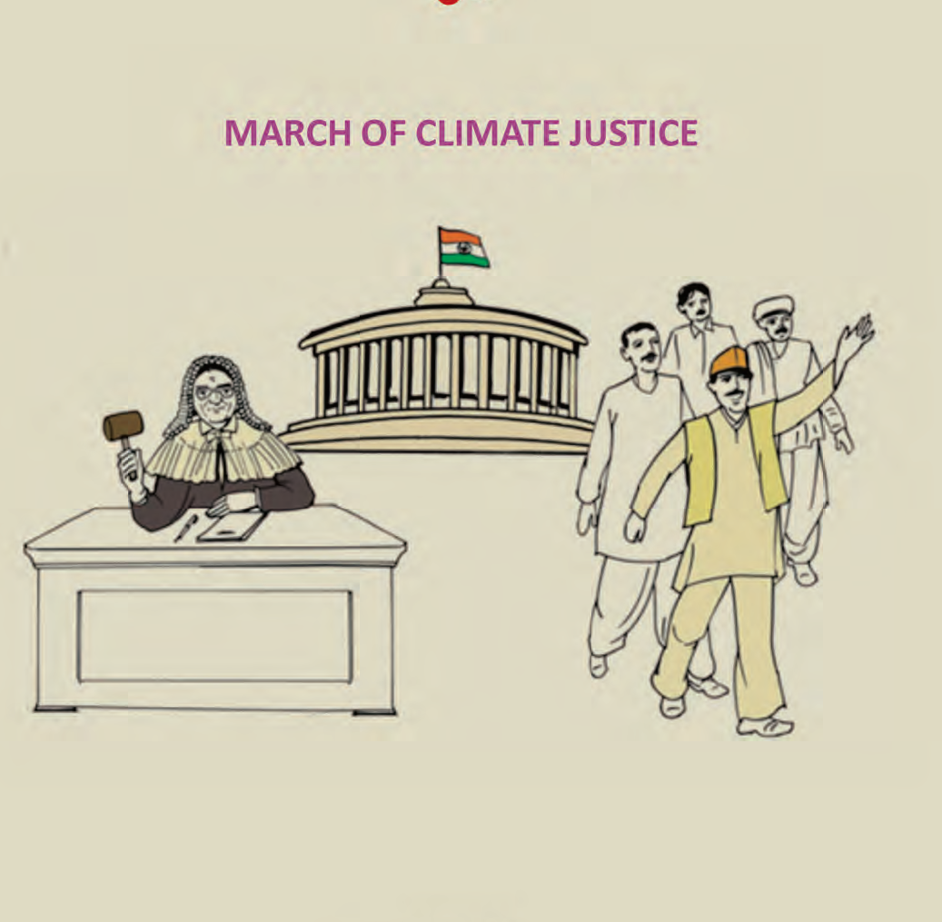
Strengthening Climate Justice Initiatives For Farmers and Agriculture: Indian perspective Climate law and Governance Day on 11th November in Marrakech
Presented by-
Dr. Kirit Shelat-Executive Chairman, NCCSD-INDIA

Slide 2
1. Highlight
The Legal basis of Climate Justice
Approaches to ensure
Timely delivery of Justice embedded in Comprehensive framework of sustainable development.
Special focus on marginalized and affected farmers
Cross cutting impacts
Precautionary approaches
Inclusive public policies
2. Hear the voices of farmers
Demonstrate inclusiveness in deliberations through their participation
Define opportunities to establish veracity of their observations to strengthen scientific temper.

Slide 3
The Contours of justice & the need for farmer focus
Facets of justice
Fairness, moral rightness and a scheme or system of law that benefits every citizen.
Natural and legal rights.
Farmer focus : Go beyond piece meal solutions
Highly vulnerable and need speedy justice
Have to tackle cross cutting consequences of Inclement weather and markets, adaptation by crops, diseases, post – harvest management
Need
Locally adapted and inclusive knowledge systems
Build on their understanding
Empowers them to access emerging knowledge
Livelihood opportunities with livestock, fisheries, land and water management, bio resources conservation
Viable and locally feasible Climate smart practices that are not “re – packaged & redundant”
Overcome drudgery
Establish other enabling circumstances including infrastructure, crop insurance, food security, alternative livelihoods, soil / water / bio resources augmentation & multiple safety nets

Slide 4
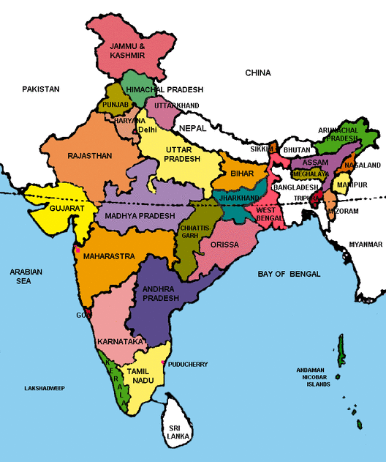
THE INDIA

Slide 5
Indian Situation
India’s success over six decades:
2 % to 3% sustainable agriculture growth
Brought many out of poverty from 90% below poverty line to 20%.
Tackled many adverse climate and geographic challenges including droughts.
Validated research into rise in productivity
Several states and individual farmers with productivity, higher than, or equal to international level
Adverse impacts of climate change pushes even successful farmers back to poverty
Farmers suicide / large scale exodus to urban centers
By 2030 India will need to produce additional 100 M. Tones for its growing population.
India had to import food in its early phase of development, but now it is self sufficient and is expected to meet this challenge successfully.

Slide 6
Small farmers stared at big losses the last monsoon season
In the Last year, 302 of 604 districts have experienced deficit rain conditions
This rainfall deficit to 10% for entire country. Last year (2014) had deficit of 12%.
Farmers were staring at poor crop with lack of soil moisture.
There was deficit in crops like wheat and pulses.
Stressed farm income have led to slump in rural wages which has further impact on rural demand.
Impact on yields of livestock and fisheries.
But Current year with good rains farmers feel better.

Slide 7
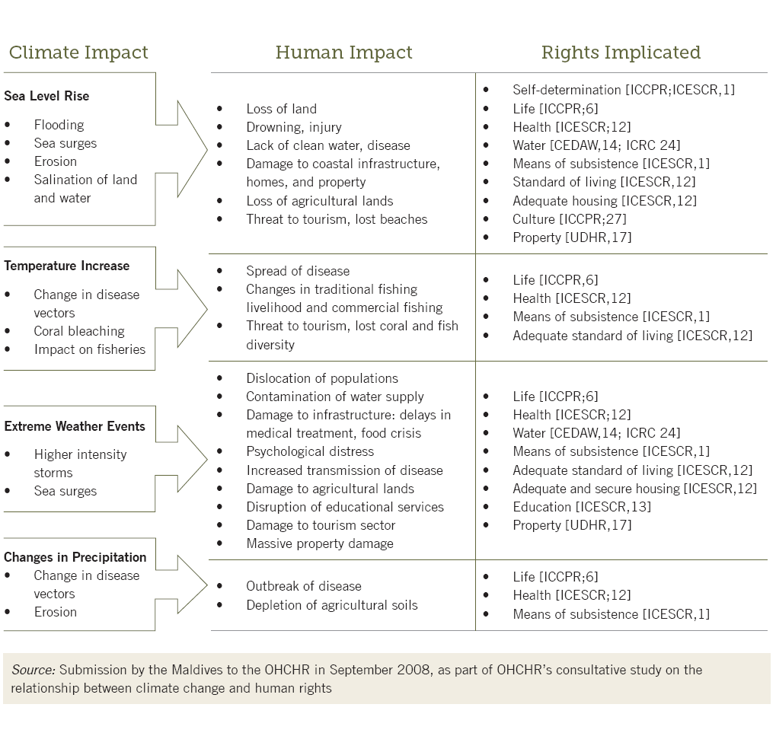
Climate change and Human Rights
Source:-OHCHR’s Consultative Study on the relationship between Climate change and Human rights

Slide 8
Observed Impact On Agriculture In India.
Industry and urban township are mostly implicated in the creating the externality through the release of pollutants and other emissions. They have to be made responsible for the challenges caused and sustained support to overcome challenges in the longer term too.
These are locally felt challenges of a global phenomenon and can be seen as externalities that the farmers are not responsible for. The stakeholders responsible for creating these challenges cannot be determined as there is no direct cause and effect relationship.

Slide 9
CLIAMTE JUSTICE- The Indian Perspective
Disaster-Reconstruction policy:
This is National Policy to provide immediate help to people affected by natural calamities-it includes advance precautionary measures like shifting of population
Government provides financial assistance to affected at time of natural calamities like floods/cyclone-
Cash doll payment-for 15 days
Assistance for Household Kit
Assistance for Replacing livestock-lost/Died.
Assistance for Repair /Restore Houses collapsed or washed Away.
Crop and cattle insurance.
Financial assistance in case of death of adult members of family

Slide 10
Employment Guarantee Scheme (Act)-MNREGA(Mahatma Gandhi National Rural Employment Guarantee Act)
This act provides assured employment in Communities Projects to those who have no source of livelihood and in certain cases even one’s own farm laborer work is permitted like Farm Pond. This is available round the year. This scheme is very popular. It has also raised rural wage of agriculture and allied workforce.

Slide 11
Crop and cattle Insurance.
Government provides
Subsidy in premium
Majority crops are including horticulture crops are Covered.

Slide 12
Minimum Support Price. (MSP) (Govt. of India, Agri .Mini Website)
Government provides a mechanism to purchase agriculture produce-include food grain at a specific price- if the market price is lower. Government sets up purchase depots to buy at MSP. This protects farmers in time of falling price due to bumper crops or Speculative Movement.

Slide 13
Food Security:
In September 2013, Government of India has introduced National Food Security Act. The Act provided for food security to both urban and rural poor. Approximately 67% of rural population-81 crore of population is entitled to receive subsidized food grain form Public Distribution System. The rate recommended imbalance are:
Rice-Rs 3/-Kg(5 kg per person/month)
Wheat –Rs 2/- Kg
Coarse Grain Rs 1/- Kg
11 states have introduced this scheme. There are some operational issues-Which are being sorted out.
This is a massive scheme and provides food security covering all rural poor families which include poor farmers.

Slide 14
Grievance Redressal-
The justice system judiciary has created legal Aid Cell- to guide and even provide a lawyer without any fees for those who cannot afford.
Lok Adalats-These are open courts to settle issues by calling aggrieved parties together.

Slide 15
Public Administration:---District Level
Government of Gujarat has setup at District level Committee headed by the Minister (In charge of District), Secretary (In charge of District) and District Collector.
Every month they meet to here aggrieved persons whose problems have not been resolved. This is a public hereing with concerned department. By District Administration from citizen-both rural and urban.
This administration works in each District effective.
Those who are not satisfied with the decision or want to take up the matter at Higher Level Department.

Slide 16
Why Climate Justice Is Needed
Despite very many schemes and statutes there are people who get left-out .These are same poor Families who are left out of development process- They have been left out because they are not get capable to reap the benefit of Schemes and not even capable of using available legal redressal System. Hence they need individual help.
This is especially at time of their crop-failure or Cattle death or Washing away of crop and soil.
This is the challenges to Public Governance System in arena of Climate Change

Slide 17
Glaring Example of Inequity -Forever Agriculture
Crop Insurance
Average settlement period (1 to 2 years) While requirement is immediate for resowing
Car Insurance and Medical Insurance -Normally Insurance company makes direct payment-Cashless provisions but farmers have to wait.
Inputs Seeds
Seeds fails to germinate or less germination in relation to quantity of seeds –but failure of certified seed-replacement is not easy-There are no warrantee provision.
But in case of Consumable and non-consumable goods immediate exchange / replacement if in case product fails to meet standards depicted

Slide 18
The International Inequality to Agriculture
There enough provision to safeguard ,Human rights in UNFCCC resolution.
But In the current discussion & policy framework Conference of parties in UNFCCC deliberations, agriculture is addressed from the point of view of food security, food to hungry millions but not from view of sustainable livelihood to farmers and role of agriculture and of farmers for mitigation is not prioritised.
Agriculture vegetation due to its unique photosynthesis process is only known technology which naturally absorbs Co2 from atmosphere and releases oxygen. This unique function is not given due importance and farmers are advised do mitigation by reducing use of fertilizer which they need get higher productivity

Slide 19
Conti….
Conversely agriculture is treated on par with industry, mines, new urban areas for releases (a) GHG-But later release directly by its operations (b) reduce absorption of Co2 which to take place by agriculture on same land acquired by them. Hence their impact on global warming is double by on the other hand.
The while calculating GHG emission by agriculture –absorption by it co2 is not given deduction. Policy framework for Carbon Credit is industry oriented. No farmer or their organisation can fill up such complicated forms to avail carbon credit-But Pandits do not recognise this-At international level in Conference of Parties.
Agriculture needs to be given recognition of the role and farmer given support as Global Warming is international phenomena but its impact is at local level ,village level and the main suffer or of these un–foreseen to foreseen calamities is farmer who tends to lose his only source of livelihood

Slide 20
Ensure Accountability and Involvement of public leadership
The government machinery strives to combat the climate adversities and the agricultural losses. The government schemes need to reach out to poorest. It is time to establish the culture of commitment through fixing the accountability to implement the scheme in spirit.
The climate Justice enables the farmers to voice their problems and Communicate and involve public leadership to ensure that poor’s-are no longer “left outs”.
The public leadership has to take up these difficult challenges head on. By Public leadership we mean both elected and non elected members of public Governance System-and it includes all three wings-the legislature, the judiciary and executive.

Slide 21
NCCSD’s Initiative-on Climate Justice
NCCSD has held an International conference on in November 2014,this was addressed by Chief Justice of India and presided over By Governor of Gujarat.
There were more than 400 participants and 150 farmers
All above issued were deliberated and conference passed follows:-

Slide 22
The conference unanimously resolved as under-March of Climate Justice
Give voice to farmers, understand their options and empower them to act.
Identify areas where there is apparent in-equity in laws, schemes, procedures and safety net provision.
Suggest inclusive sustainable legal and administrative process with the involvement of all stakeholders to reduce inequality through appropriate redresal system and with protective assistance to get it and declare authorities responsible for its regulation and make them accountable
Strengthen governance through local level public leadership who should be made statutorily responsible eg. Communicate to entire village weather forecast and agro advisory.-

Slide 23
Conti……..
Improvement in existing legal framework and tools to suggest ensuring preventive and remedial action to reduce vulnerability through transparent credible, long – lasting and effective but quick enforcement of climate and related policies.
To develop capacity building programmes which to trains farmers in Climate Smart Agriculture make them ready to give voice to their concern and sharing of their difficulties with leadership initiatives.
To design and develop sustainable development with built in legal framework to ensure effective implementation and accountability of those in public and private Governance System who are responsible to provide it.

Slide 24
Conti……….
To disseminate information on weather and Agro-advisory with Vice chancellor of Agriculture Universities are responsible to make that available.
To lead a smooth transition process through which income does not become less, but it grows gradually like that of non-farm sector, despite adverse impacts.
To prepare future generation of farmers and leaders to convert these adversities in to opportunity.

Slide 25
Conti…..
It is urged that united Nation and UNFCCC and Conference of Parties take note of direct impact of Global Warming on farmers and related impact on Food Security for hungry millions and enhanced social-turmoil resulting into violence and deaths of poor people.
It is urged that Global resources be diverted to support poor farmers, provide technology transfer “Those who have it to those who need it” to bridge productivity gaps and climate Smart Agriculture.
It was uniformly further resolved that participants conference-Which included farmers-that international community will find just and smart way to provide them relief for act and omission of others.

Slide 26
About NCCSD
NCCSD is the outcome of the deliberations that took place during an International Conference on “Global Warming, Agriculture, Sustainable Development & Public Leadership” which was organized at the Gujarat Vidyapith – Ahmedabad in March 2010 by the International School for Public Leadership (ISPL) along with other organizations. In a Round Table Meet at New Delhi in April, 2010, presided by Prof. M S Swaminathan and Justice B P Singh, it was felt that a special organization needs to be created to follow up ideas and it was decided to setup "National Council for Climate Change, Sustainable Development and Public Leadership” (NCCSD).
NCCSD is promoting Sustainable and Climate Resilient Agriculture with the involvement of Public Leadership. NCCSD has become leading Environmental NGO under the leadership of our President Justice B. P. Singh, Formerly Judge, Supreme Court of India. NCCSD is a non-profit organization. The NCCSD was registered under Bombay Charitable Trust Act 1950 Rule-29-No. E/19344/Ahmedabad as Public Trust on 17th September 2010. Its mission is to promote sustainable livelihood, climate resilient & sustainable agriculture in arena of global warming.

Slide 27
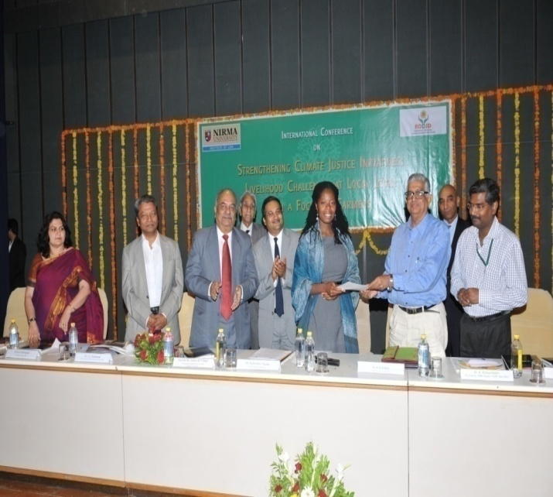
NCCSD has signed MOU with Florida Agricultural and Mechanical University (FAMU) for technology transfer and collaborative. Executive Director of Sustainability Institute Ms. Abena Ojetayo visited India in November, 2014 and participated in International Conference on Climate Justice organized by NCCSD.

Slide 28
WHAT WE DO?
NCCSD is organizing Inter-action Meet and Think-Tank Meet for policy formulation and sensitization on issues related to farmers with their participation.
NCCSD is organizing Interactive and Capacity Building to Farmers with focus on local level leaders, young farmers and women farmers.
It is train to young faculty members and students on Leadership and Climate Smart Agriculture.
NCCSD is conducting action research work for developing communication modules including guidebook, posters and documentary films for farmers.
NCCSD is sensitizing State and Central Government on important policy issues which concern farmers. It is also taking up similar issues with UNFCCC and UN at international level
NCCSD is publishing books on important issues related to farmers and agriculture.

Slide 29
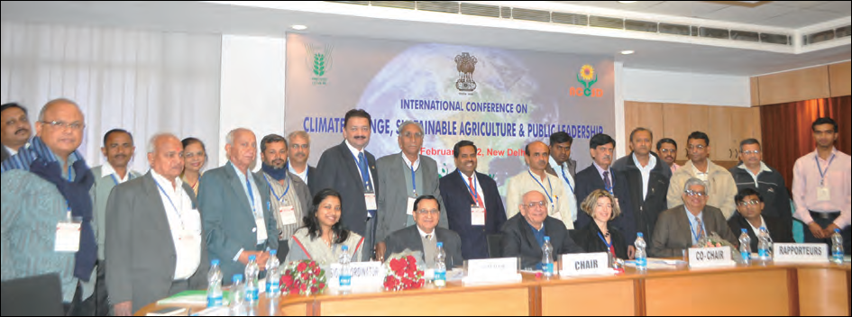
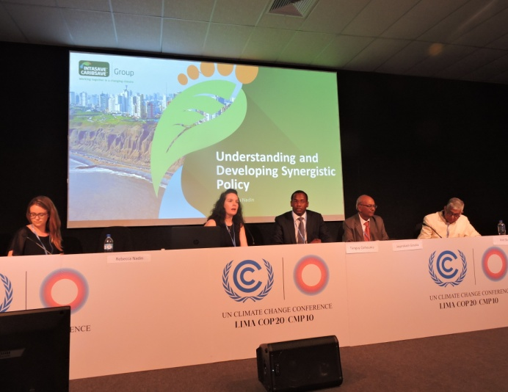
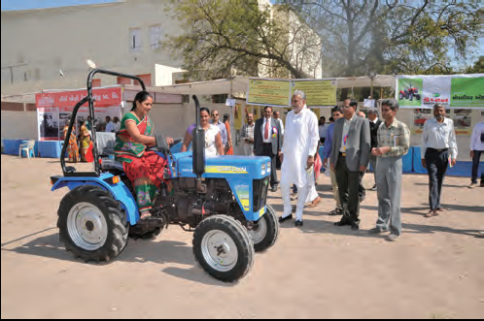
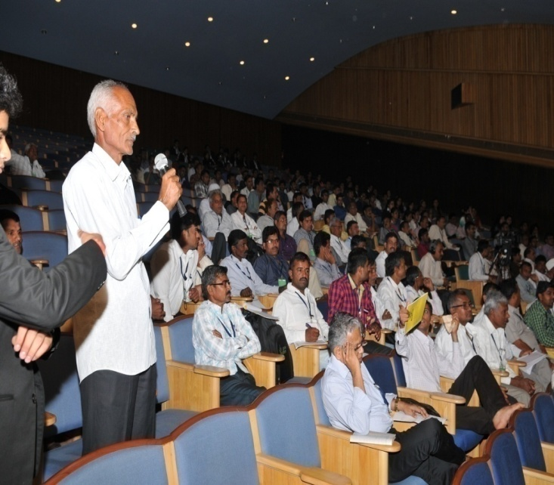
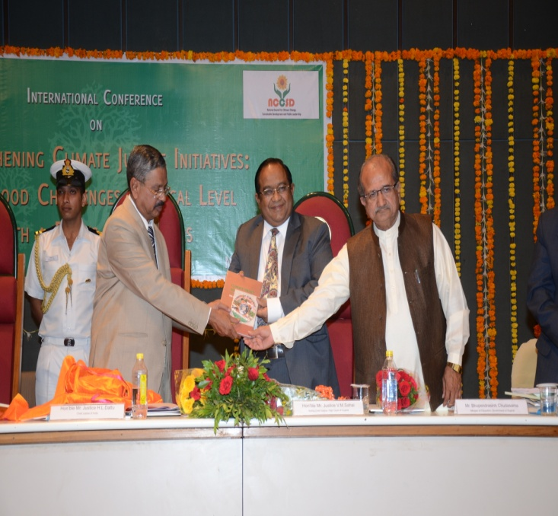
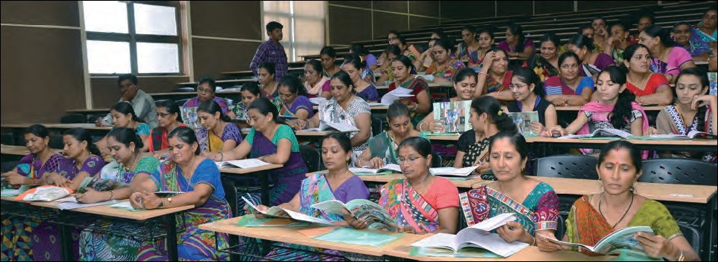

Slide 30
Thank You for your patient hearing
DR. KIRIT N SHELAT, IAS (RTD) Executive Chairman National Council for Climate Change Sustainable Development and Public Leadership (NCCSD) Patel Block, Rajdeep Electronic's Compound, Near Stadium Six Road, Navrangpura, Ahmedabad-380 0014 Phone/Fax: (00 91 79) 26421580 Mobile: 091 9904404393 Email: drkiritshelat@gmail.com, Website: www.nccsdindia.org

